Slide 1
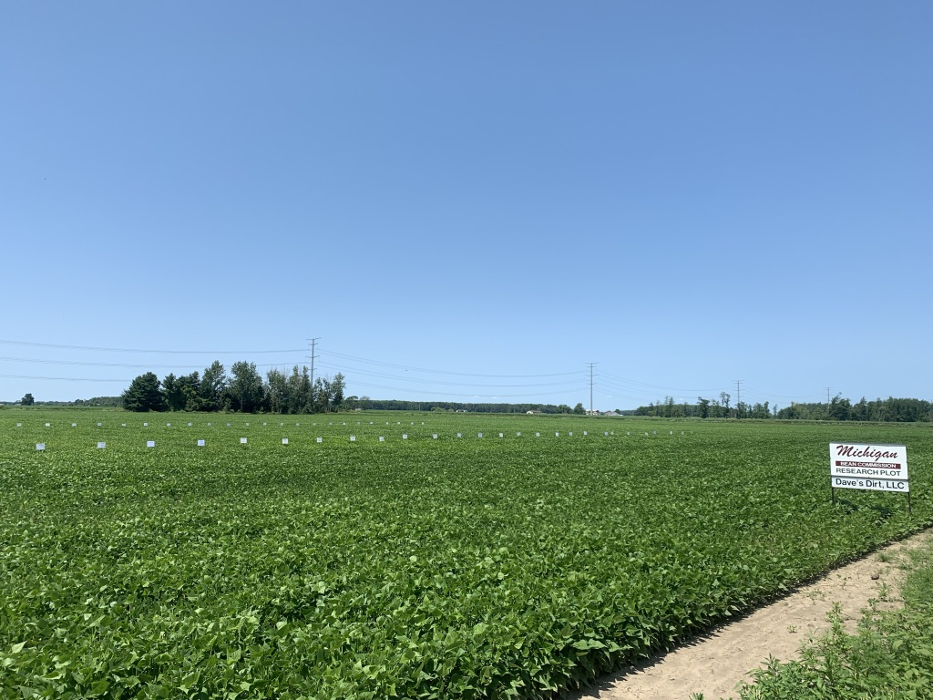
2019 PRAB Dry Bean Variety, Fungicide & Fertility Trials
Scott Bales
MSU Dry Bean Specialist

Slide 2
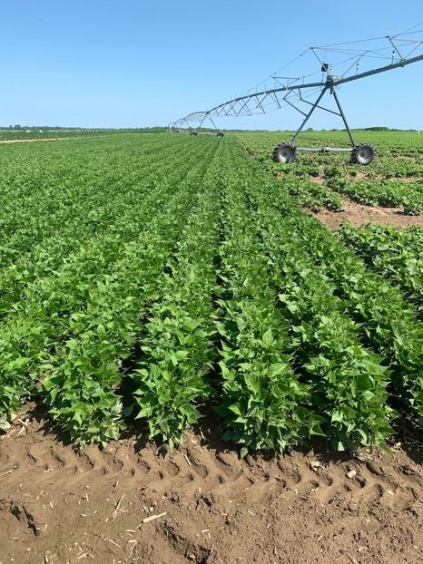
Dry Bean Research 2019
New relationship between MBC and MSU
2019 transition year
Located at SVREC
78 separate Trials in 14 Locations
Challenging year from start to finish
Scott Bales- MSU Dry Bean Specialist

Slide 3
SVREC- Richville, MI
Total rainfall (inches)
2019
2018
2017
2016
2015
2014
Scott Bales- MSU Dry Bean Specialist

Slide 4
SVREC- Richville, MI
Total rainfall (inches)
Daily rainfall (inches)
Total Rainfall
Daily Rainfall

Slide 5
SVREC- Richville, MI
Daily rainfall (inches)
2019
5-year average
Scott Bales- MSU Dry Bean Specialist

Slide 6
Crop Progress & Condition- Michigan
USDA-NASS
Planting progress (%)
Scott Bales- MSU Dry Bean Specialist

Slide 7
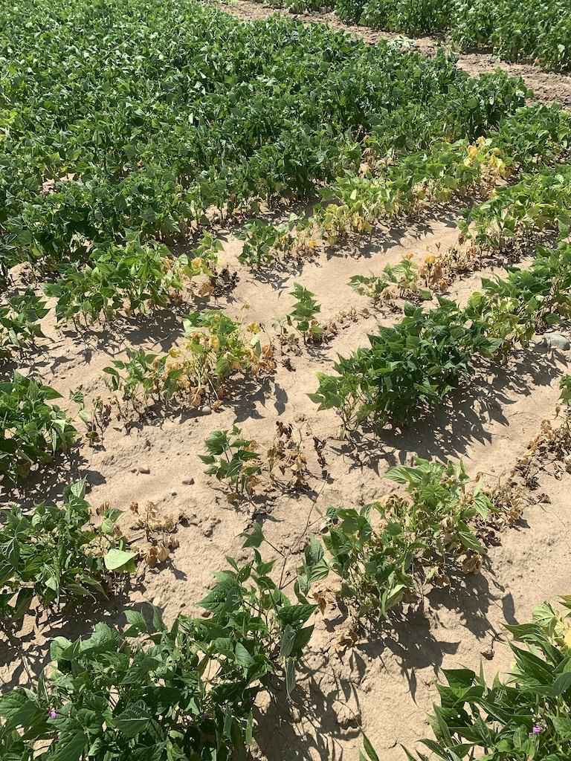
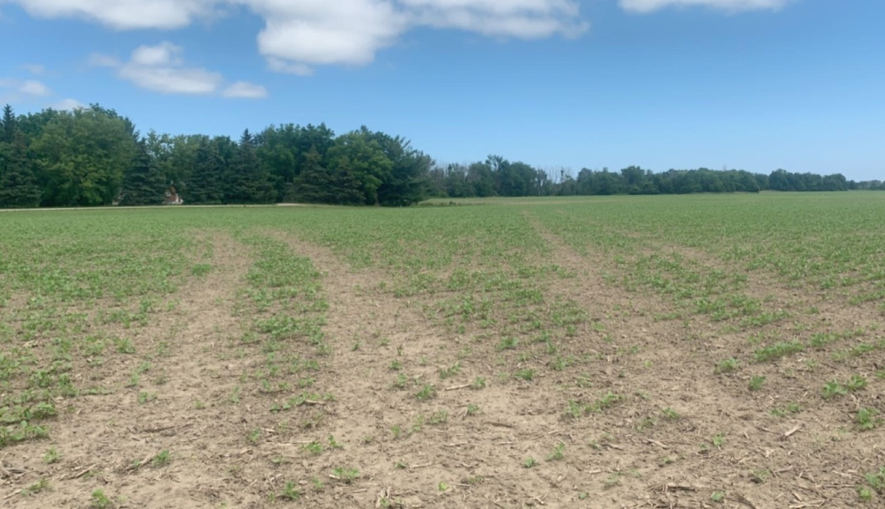
Results of a difficult planting season
Compaction & uneven crop progress
Widespread minor root rot symptomology

Slide 8
PRAB Variety Trials
County | Cooperator | Planting Date | Harvest Date
Bay | Schindler Farms | 6/8 | 9/18
Gratiot | Steve Hoard Farms | 6/8 | 10/9
Sanilac | Dave’s Dirt | 6/9 | 9/24
Tuscola | Bednarski Farms | 6/9 | 9/26
Montcalm | Rader Farms | 6/12 | 10/10
Huron | J.A.D.E. Farms | 6/22 | 10/7
Scott Bales- MSU Dry Bean Specialist

Slide 9
PRAB Variety Trials (Navy)
VARIETY | BAY | HURON | SANILAC | TUSCOLA | 1-year AVG. | 2-year AVG. | 3-year AVG.
HMS MEDALIST | 1834* | 2934 | 3619* | 2682 | 2767 | 2714 | 2599
MERLIN | 1766* | 3231 | 2682 | 2150 | 2457 | 2816* | 2623
APEX | 1769* | 2911 | 3448* | 2974 | 2776* | 2872* | -
BLIZZARD | 1476* | 3176 | 3064 | 2859 | 2644 | 2708 | 2565
INDI | 1442 | 3182 | 2547 | 2476 | 2412 | 2529 | -
VIGILANT | 2024** | 3199 | 2437 | 2817 | 2619 | - | -
REXETER | 1544* | 3923** | 2371 | 3148 | 2747 | 2645 | 2540
NAUTICA | 1919* | 3131 | 2402 | 2854 | 2577 | 2432 | 2497
MIST | 1748* | 3258 | 2969 | 2660 | 2659 | 2645 | 2499
ARGOSY | 1896* | 3374 | 3173* | 2973 | 2854* | 2846* | 2841*
VALIANT | 1332 | 3151 | 3208* | 2430 | 2530 | - | -
PROVITA 12039 | 1828* | 3067 | 3651** | 3410* | 2989 | 3032** | 2912**
HMS BOUNTY | 1441 | 3164 | 2655 | 2902 | 2541 | 2981* | 2782*
ARMADA | 1541* | 3530* | 3575* | 2821 | 2867* | 2956* | 2823*
MEAN: | 1578 | 3169 | 2835 | 2750 | 2618 | 2731 | 2701
Scott Bales- MSU Dry Bean Specialist

Slide 10
PRAB Variety Trials (Black)
VARIETY | BAY | HURON | SANILAC | TUSCOLA | 1-year AVG. | 2-year AVG. | 3-year AVG.
ZORRO | 1470 | 2416 | 3138* | 2816 | 2460 | 2540 | 2426
ZENITH | 1539 | 2625* | 3282* | 2506 | 2488 | 2673 | 2504
LORETO | 1123 | 2721* | 2977 | 3055 | 2469 | 2694 | 2643
BLACK CAT | 1595 | 2535 | 2750 | 2790 | 2418 | 2618 | 2552
BLACK BEAR | 1466 | 2657* | 3227 | 3612 | 2741 | 2672 | 2539
BLACK TAILS | 1259 | 2609 | 2788 | 3432 | 2522 | 2740 | 2639
BLACK BEARD | 1909* | 3193* | 3782** | 3195 | 3020* | 3190* | 3040
SPECTRE | 1625 | 2719* | 3514* | 3190 | 2762 | 3122* | 3009
BL 13505 | 1903* | 2973* | 2793 | 3047 | 2679 | 2743 | 2652
BL 14500 | 1979* | 3060* | 3563* | 3563 | 3041* | 3337** | 3224**
BL 15610 | 1546 | 2524 | 3739* | 3284 | 2773 | 2749 | -
BL 15619 | 2069* | 2588 | 2540 | 2876 | 2518 | 2558 | -
MSU B16504 | 2229** | 2845* | 3308* | 2768 | 2788 | 3109* | 3074
MSU B18201 | 2136* | 3282** | 3329* | 4268** | 3254** | - | -
MSU B18504 | 1675 | 3099* | 3343* | 3700* | 2954 | 3068 | -
MEAN: | 1718 | 2827 | 3039 | 3207 | 2726 | 2779 | 2775
Scott Bales- MSU Dry Bean Specialist

Slide 11
PRAB Variety Trials (Small Red and Pink)
VARIETY | BAY | HURON | SANILAC | TUSCOLA | 1-year AVG. | 2-year AVG. | 3-year AVG.
VIPER | 1882* | 2610* | 3608* | 3885* | 2996** | 3162* | 3175**
RUBY | 1472* | 2644* | 2970 | 2855 | 2485 | 2710 | 2725
CALDERA | 1578* | 2299* | 3641** | 4237** | 2939* | 3020* | 3084*
CAYENNE | 1859* | 2777* | 2942 | 3328 | 2727* | 3097* | 3032*
MSU R17603 | 1594* | 2880** | 3560* | 2990 | 2756* | 3207** | -
MSU R17604 | 1378 | 2450* | 3130* | 3302 | 2565 | - | -
MSU R17605 | 1537* | 2453* | 3043* | 3422 | 2614 | - | -
PROVITA 16686 | 1801* | 1702 | 2503 | 3955* | 2490 | - | -
PROVITA 17835 | 1865** | 2453* | 2919 | 2704 | 2485 | - | -
PROVITA 17837 | 1335 | 2682* | 3167* | 3177 | 2590 | - | -
PROVITA 17839 | 1294 | 2461* | 2982 | 2528 | 2316 | - | -
ROSETTA PINK | 1542* | 2561* | 2075 | 2021 | 2050 | 2561 | 2528
S18904 | 1705* | 2256 | 3067* | 2757 | 2446 | - | -
MEAN: | 1603 | 2479 | 3047 | 3166 | 2574 | 2960 | 2909
Scott Bales- MSU Dry Bean Specialist

Slide 12
PRAB Variety Trials (Pinto)
VARIETY | BAY | GRATIOT | HURON | MONTCALM | SANILAC | 1-year AVG.
LA PAZ | 1922* | 2127 | 2271* | 2291 | 2934** | 2309
MSU P16901 | 2188* | 2671** | 2368* | 2639 | 2322* | 2438*
MSU P17510 | 2223** | 2250* | 2618** | 3384** | 2792* | 2653**
MSU P18602 | 1345 | 1862 | 2316* | 1394 | 2661* | 1916
WINDBREAKER | - | - | 2071 | - | - | -
SV6139GR | - | - | 2496* | - | - | -
SV6533GR | - | - | 2422* | - | - | -
MEAN: | 1920 | 2228 | 2366 | 2427 | 2677 | 2329
Scott Bales- MSU Dry Bean Specialist

Slide 13
PRAB Variety Trials (Great Northern)
VARIETY | BAY | GRATIOT | MONTCALM | TUSCOLA | 1-year AVG. | WM Rating
POWDERHORN | 883 | 1295 | 3097* | 1229 | 1626 | 5.0
MSU G16351 | 2066** | 2627* | 3142* | 3204* | 2760* | 3.0
MSU G17410 | 2001* | 2845** | 3818** | 3416** | 3020** | 3.0
ARIES GN | 1246 | 1588 | 3160* | 1748 | 1936 | 5.0
GN 13172 | 1525* | 2331 | 2740 | 3213* | 2452 | 4.0
MEAN: | 1544 | 2137 | 3191 | 2562 | 2359 | 4.0
Scott Bales- MSU Dry Bean Specialist

Slide 14
PRAB Variety Trials (Cranberry)
VARIETY | GRATIOT | MONTCALM | Irrigated 2-year AVG. | Irrigated 3-year AVG. | Dry Land 2-year AVG. | Dry Land 3-year AVG.
ETNA | 707 | 4109** | 3512* | 3335 | 1803 | 1941
CHIANTI*** | 731 | 3780* | 3607* | 3365 | 1918 | 2411
BELLAGIO*** | 1585* | 3405 | 3568* | 3336 | 2263 | 2441
SV3709GC | 1382* | 3970* | - | - | - | -
VERO | - | 3468 | 3276 | 3368 | - | -
GTS Red Cran R172 | 1719* | 2721 | - | - | - | -
CR 151085 | 1773* | 3601* | 3909** | 3783** | 2460* | 2674*
CR 151093 | 1853** | 3228 | 3285 | 3149 | 2704** | 2773**
CR 151106 | 562 | 3977* | 3474* | 3226 | 1739 | 2030
CR 16760 | 1623* | 3566 | 3345 | - | 2506* | -
CR 16761 | 1141 | 3568 | 3561* | - | 2141 | -
CR 16764 | 1351 | 3143 | 2703 | - | 2235 | -
CR 16775 | 1153 | 3483 | - | - | - | -
MEAN: | 1298 | 3540 | 3424 | 3366 | 2197 | 2378
Scott Bales- MSU Dry Bean Specialist

Slide 15
PRAB Variety Trials (Light Red Kidney)
VARIETY | GRATIOT | MONTCALM | Irrigated 2-year AVG. | Irrigated 3-year AVG. | Dry Land 2-year AVG. | Dry Land 3-year AVG.
CALIF ELRK | 1493 | 3630* | 3162 | 3288* | 1808 | 2049
CLOUSEAU | 1380 | 3763** | 3581* | 3696* | 1943 | 2160
INFERNO | 2521 | 2447 | 3541* | 3546* | 2853** | 2936**
BIG RED | 1937 | 3136* | 2999 | 3350* | 2018 | 2211
RONNIES RED | 2607* | 2824 | 3643* | 3762** | 2669* | 2855*
RED DAWN | 1491 | 3654* | 3493* | 3557* | 1854 | 2102
LRK 06269 | 2202 | 2982* | 3675* | 3491* | 2209 | 2321
LRK 15907 | 2577* | 2421 | 2952 | 3106 | 2638* | 2802*
LRK 15926 | 2142 | 2426 | 3037 | 3016 | 2312 | 2521*
COHO | 2435* | 2699 | 3432* | 3182 | 2443 | 2291
MSU K17703 | 1922 | 3372* | 3978** | - | 2350 | -
MSU K18501 | 2642** | 2767 | - | - | - | -
ADM L1032326 | - | 2594 | - | - | - | -
ADM L4063262 | - | 2851 | - | - | - | -
MEAN: | 2112 | 2969 | 3408 | 3400 | 2282 | 2425

Slide 16
PRAB Variety Trials (Dark Red Kidney)
VARIETY | GRATIOT | MONTCALM | Irrigated 2-year AVG. | Irrigated 3-year AVG. | Dry Land 2-year AVG. | Dry Land 3-year AVG.
RED HAWK | 1877 | 3708* | 3745 | 3558* | 2123 | -
MONTCALM | 1823 | 3433* | 3685 | 3504* | 1986 | -
RED ROVER | 1761 | 3567* | 3468 | 3343* | 2023 | -
DYNASTY | 2017 | 3506* | 3923 | 3697** | 2397* | -
RED CEDAR | 2099 | 2684 | 3140 | 3018 | 2263 | 2673
MSU K16131 | 1928 | 2637 | 3219 | - | 2133 | -
MSU K16136 | 1950 | 3277* | 3575 | 3681* | 2325 | -
CHAPARRAL | 1556 | 2638 | 3504 | 3197 | 1922 | -
EPIC | 2044 | 3199* | 3415 | 3360* | 2289 | 3272*
SPIRE | 2083 | 2302 | 3721 | 3309 | 2295 | 3407**
RAMPART | 1673 | 2892 | 3429 | - | 2088 | -
DRK 15978 | 2652** | 2181 | 3920 | 3233 | 2629** | -
ADM D1034333 | - | 3883** | - | - | - | -
ADM D5004231 | - | 3799* | - | - | - | -
MEAN: | 1951 | 3019 | 3556 | 3380 | 2219 | 3117
Scott Bales- MSU Dry Bean Specialist

Slide 17
PRAB Variety Trials (White Kidney)
VARIETY | GRATIOT | MONTCALM | Irrigated 2-year AVG. | Irrigated 3-year AVG. | Dry Land 2-year AVG. | Dry Land 3-year AVG.
BELUGA | 2392** | 2659 | 3083 | 2983 | 2365* | -
SNOWDON | 1418 | 4243* | 3611* | 3316 | 2081* | -
MSU K16924 | 1899* | 4317* | 4034** | 3846** | 2234* | 2348
MSU K17804 | 2237* | 3261 | 3615* | - | 2468** | -
MSU K18912 | 1549 | 4451** | - | - | - | -
YETI | 1477 | 3849 | 3820* | 3608* | 2261* | -
MEAN: | 1829 | 3797 | 3632 | 3438 | 2282 | -
Scott Bales- MSU Dry Bean Specialist

Slide 18
PRAB Variety Trials (Yellow)
VARIETY | GRATIOT | MONTCALM | Irrigated 2-year AVG. | Dry Land 2-year AVG.
MSU Y16503 | 1546 | 3519* | 3154 | 2177
MSU Y16507 | 1915* | 3914** | - | -
PROVITA 13655 | 1917** | 3287 | - | -
SVS 0863 | 1840* | 3387 | - | -
MEAN: | 1805 | 3527 | - | -
Scott Bales- MSU Dry Bean Specialist

Slide 19
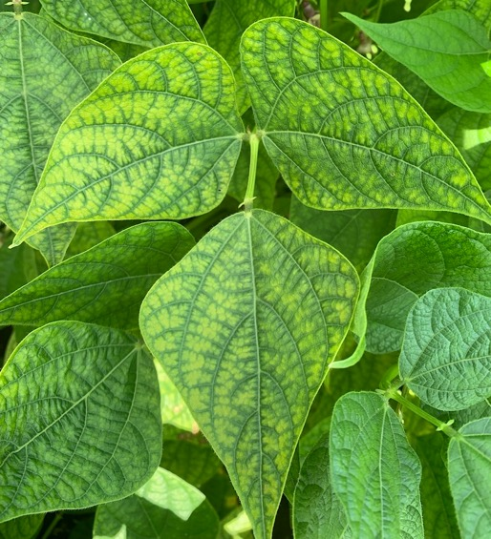
Dry Bean Fertility 2019
In late 2018 funds were obtained to study soil fertility and plant nutrition
‘Comprehensive Fertilizer Rate Recommendations For Michigan Dry Bean Growers’
2-3 year project
Scott Bales- MSU Dry Bean Specialist

Slide 20
Dry Bean Fertility
Trial | Planting Date | Harvest Date
Phosphorus “Strip Trial” | 6/7 | 10/19
Foliar Manganese Trail | 6/7 | 10/19
Nitrogen Rate Response | 6/19 | 10/7
Sulfur Rate Response | 6/19 | 10/7
Nitrogen Strip Trial | 7/1 | 10/14
Scott Bales- MSU Dry Bean Specialist

Slide 21
PRAB Variety Trial Soil Test
Location | OM (%) | Bray 1 (ppm) | K (ppm) | Mg (ppm) | pH | CEC | S (ppm) | Zn (ppm) | Mn (ppm) | Boron (ppm) | Nitrate (ppm) | Ammonium (ppm)
Bay | 1.9 | 35 | 180 | 270 | 8.1 | 13.2 | 8 | 5.8 | 35 | 1 | 7 | 1
Sanilac | 3.9 | 43 | 153 | 205 | 7.5 | 11.4 | 13 | 2.8 | 10 | 1 | 26 | 1
Huron | 2.9 | 72 | 178 | 340 | 7.7 | 14.5 | 11 | 9.3 | 26 | 1.5 | 12 | 1
Tuscola | 2.3 | 48 | 194 | 300 | 7.8 | 13.2 | 9 | 3.7 | 40 | 1.2 | 12 | 2
Gratiot | 2.2 | 30 | 121 | 245 | 7.7 | 8.9 | 8 | 6.5 | 36 | 0.8 | 8 | 1
Montcalm | 1.5 | 190 | 156 | 90 | 6.7 | 4.4 | 9 | 9.7 | 44 | 0.2 | 13 | 3
Scott Bales- MSU Dry Bean Specialist
Notes:
7-13= about 30 LB. Nitrogen credit based on Nitrates

Slide 22
PRAB Variety Trial Tissue Test (R1)
Variety | Class | Location | Yield | N | S | P | K | Mg | B (ppm) | Zn (ppm) | Mn (ppm)
Merlin | Navy | Bay | 1776 | 4.16 | 0.25 | 0.41 | 1.94 | 0.39 | 32 | 35 | 31
Zorro | Black | Bay | 1470 | 4.46 | 0.27 | 0.43 | 1.69 | 0.44 | 38 | 33 | 25
Black Bear | Black | Bay | 1466 | 4.33 | 0.25 | 0.47 | 2.07 | 0.45 | 37 | 32 | 22
Viper | S. Red | Bay | 1882 | 4.6 | 0.26 | 0.46 | 1.94 | 0.38 | 40 | 35 | 33
Merlin | Navy | Huron | 3231 | 5.78 | 0.31 | 0.6 | 2.51 | 0.32 | 32 | 43 | 23
Zorro | Black | Huron | 2416 | 5.32 | 0.31 | 0.51 | 2.26 | 0.34 | 41 | 35 | 28
Black Bear | Black | Huron | 2657 | 4.73 | 0.28 | 0.39 | 2.3 | 0.39 | 33 | 27 | 24
Viper | S. Red | Huron | 2610 | 5.57 | 0.3 | 0.43 | 2.76 | 0.35 | 43 | 28 | 29
Merlin | Navy | Sanilac | 2682 | 7.43 | 0.47 | 0.81 | 3.54 | 0.56 | 32 | 51 | 18
Zorro | Black | Sanilac | 3138 | 7.38 | 0.47 | 0.73 | 3.26 | 0.62 | 41 | 50 | 15
Black Bear | Black | Sanilac | 3227 | 4.68 | 0.31 | 0.51 | 3.32 | 0.5 | 32 | 30 | 29
Viper | S. Red | Sanilac | 3608 | 5.06 | 0.33 | 0.57 | 2.77 | 0.55 | 37 | 35 | 35
Merlin | Navy | Tuscola | 2150 | 5.81 | 0.36 | 0.72 | 3.38 | 0.47 | 33 | 46 | 36
Zorro | Black | Tuscola | 2816 | 5.13 | 0.36 | 0.66 | 3.23 | 0.49 | 43 | 42 | 36
Black Bear | Black | Tuscola | 3612 | 6.53 | 0.42 | 0.57 | 3.32 | 0.59 | 30 | 33 | 15
Viper | S. Red | Tuscola | 3885 | 7.16 | 0.42 | 0.64 | 3.54 | 0.6 | 36 | 36 | 16
Scott Bales- MSU Dry Bean Specialist

Slide 23
PRAB Variety Trial Tissue Test (R1)
Variety | Class | Location | Yield | N | S | P | K | Mg | B (ppm) | Zn (ppm) | Mn (ppm)
Merlin | Navy | Gratiot | 2062 | 5.22 | 0.3 | 0.53 | 2.5 | 0.43 | 32 | 50 | 36
Zorro | Black | Gratiot | 2383 | 5.18 | 0.31 | 0.46 | 2.81 | 0.51 | 41 | 52 | 55
Black Bear | Black | Gratiot | - | 4.93 | 0.3 | 0.41 | 2.94 | 0.52 | 37 | 40 | 37
La Paz | Pinto | Gratiot | 2127 | 5.41 | 0.31 | 0.65 | 3 | 0.41 | 38 | 48 | 47
Viper | S. Red | Gratiot | - | 5.56 | 0.28 | 0.46 | 2.4 | 0.47 | 37 | 42 | 36
Etna | Cran. | Gratiot | 707 | 4.38 | 0.27 | 0.49 | 1.92 | 0.62 | 33 | 33 | 37
Cal. Early | LRK | Gratiot | 1493 | 4.27 | 0.26 | 0.47 | 1.89 | 0.63 | 39 | 41 | 35
Merlin | Navy | Montcalm | 2251 | 5.29 | 0.35 | 0.71 | 2.94 | 0.37 | 32 | 52 | 69
Zorro | Black | Montcalm | 2719 | 4.69 | 0.34 | 0.62 | 3.34 | 0.42 | 36 | 47 | 92
Black Bear | Black | Montcalm | - | 4.92 | 0.31 | 0.64 | 3.19 | 0.4 | 30 | 40 | 68
La Paz | Pinto | Montcalm | 2291 | 5.2 | 0.3 | 0.78 | 3.35 | 0.35 | 35 | 54 | 75
Viper | S. Red | Montcalm | - | 5.78 | 0.35 | 0.66 | 3.38 | 0.39 | 35 | 43 | 58
Cal. Early | LRK | Montcalm | 3630 | 4.49 | 0.24 | 0.46 | 3.24 | 0.37 | 20 | 31 | 36
Etna | Cran. | Montcalm | 4109 | 4.49 | 0.29 | 0.55 | 3.55 | 0.38 | 21 | 30 | 34
Scott Bales- MSU Dry Bean Specialist

Slide 24
Phosphorus
Small scale strip trial was established with two market classes
MAP was spread and incorporated preplant
All treatments balanced to 60 lb/A of nitrogen
Scott Bales- MSU Dry Bean Specialist

Slide 25
Phosphorus
Treatment | Phosphorus (lb/A) | Variety | Yield | Variety | Yield
1 | 0 | Merlin | 3553 A | Black Bear | 3251 B
2 | 25 | Merlin | 3354 AB | Black Bear | 3235 AB
3 | 50 | Merlin | 3466 AB | Black Bear | 3634 AB
4 | 100 | Merlin | 3439 AB | Black Bear | 3333 AB
5 | 150 | Merlin | 3002 B | Black Bear | 3659 A
6 | 200 | Merlin | 3286 AB | Black Bear | 3396 AB
* Means within the same column followed by the same letter are not significantly different (α ≤ 0.05).
Scott Bales- MSU Dry Bean Specialist

Slide 26
Nitrogen
Both a strip trial, and replicated small plot study were established
Potential interaction with white mold?
Strip trial: Unionville, MI
Blizzard navy beans
Small plot: Bach, MI
Black Bear black beans
Scott Bales- MSU Dry Bean Specialist

Slide 27
Nitrogen Strip Trial
Yield (lb/ A)
Nitrogen Rate (lb/A)
Scott Bales- MSU Dry Bean Specialist

Slide 28
Small Plot Nitrogen
Treatment | Nitrogen (lb/A) ^{(UAN)} | Sulfur (lb/A) ^{(ATS)} | Yield* | White Mold* (% Infection)
1 | 0 | 0 | 4446 AB | 32 A
2 | 20 | 0 | 3855 B | 62 B
3 | 40 | 0 | 4292 AB | 42 AB
4 | 60 | 0 | 4519 AB | 43 AB
5 | 80 | 0 | 4913 A | 33 A
6 | 120 | 0 | 3892 B | 56 AB
7 | 40 | 15 | 3752 B | 65 B
8 | 60 | 15 | 4459 AB | 45 AB
* Means within the same column followed by the same letter are not significantly different (α ≤ 0.05).
Scott Bales- MSU Dry Bean Specialist

Slide 29
Small Plot Nitrogen 2019 Tissue test (R1)
Treatment | Nitrogen (lb/A) ^{(UAN)} | N (%) | S (%)
1 | 0 | 4.6 | 0.30
4 | 60 | 4.6 | 0.29
6 | 120 | 4.7 | 0.31
Scott Bales- MSU Dry Bean Specialist

Slide 30
Soil Test (7/18) UTC Plots
OM% | Bray 1 | K | pH | CEC | Mn | S | Zn | Nitrate | Ammonium
2.2 | 76 | 206 | 7.7 | 12.5 | 48 | 10 | 9.6 | 20 | 2
Scott Bales- MSU Dry Bean Specialist

Slide 31
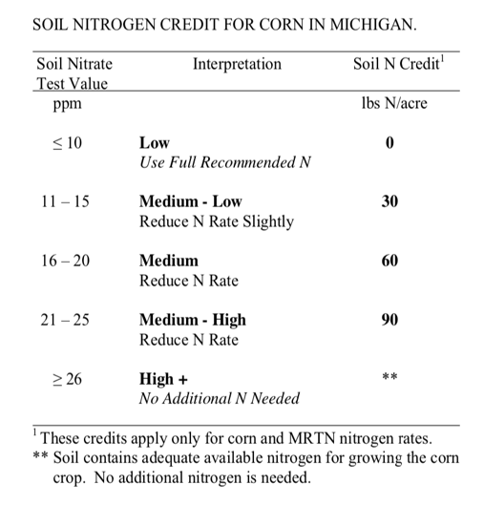
Residual Nitrogen?
Nitrate | Ammonium
20 | 2
Scott Bales- MSU Dry Bean Specialist

Slide 32
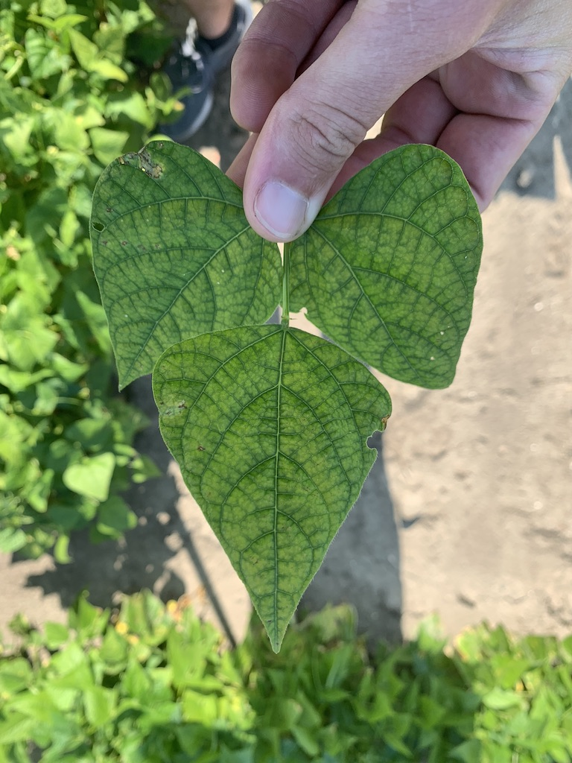
Manganese
Symptoms of Manganese deficiency were detected both visually and confirmed by R1 tissue test
Black bear black beans
Under irrigation in Midland County
7 treatments total treatments were applied
Scott Bales- MSU Dry Bean Specialist

Slide 33
Manganese
Treatment | Product | Rate A⁻¹ | Mn (lb/A) | Yield
1 | UTC | - | - | 4526
2 | Axilo Mn 13% | 1 Pound | 0.13 | 4730
3 | Axilo Mn 13% | 2 Pounds | 0.26 | 4758
4 | Axilo Mn 13% | 3 Pounds | 0.39 | 4816
5 | ELE-MAX Mn 27.4% | 1 PINT* | 0.52 | 4737
6 | ELE-MAX Mn 27.4% | 2 PINTS* | 1.04 | 4695
7 | ELE-MAX Mn 27.4% | 3 PINTS* | 1.56 | 4402
*ELE-MAX Manganese contains 3% Nitrogen by formulation
Scott Bales- MSU Dry Bean Specialist

Slide 34
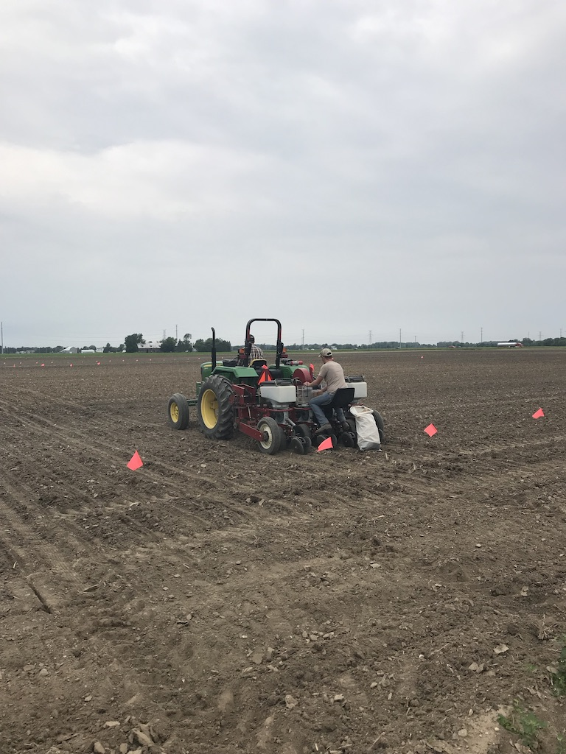
Sulfur
A small plot replicated trial was established in 2019
Bach, MI
5 Rates of sulfur were applied before dry beans emerged
All treatments received 60 Lb/A of nitrogen
Source: UAN & ATS
Scott Bales- MSU Dry Bean Specialist

Slide 35
Sulfur
Yield (lb/ A)
Sulfur Rate (lb/ A)
Scott Bales- MSU Dry Bean Specialist
* Means within the same column followed by the same letter are not significantly different (α ≤ 0.05).
Notes:
Tissue test at R1 were also not signifigant

Slide 36
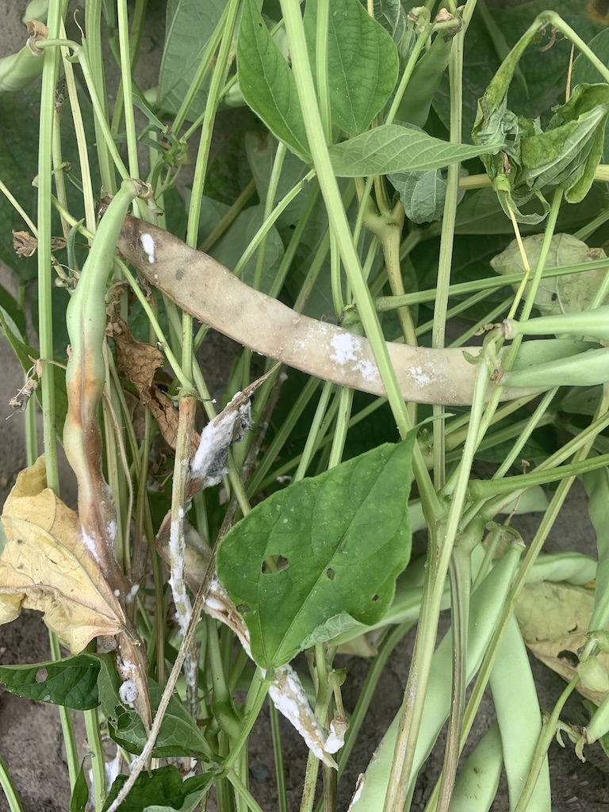
White Mold Fungicide Trials
3 separate trials established under irrigation
Montcalm Research Center
Midland County
All application made with research backpack sprayer
22 GPA at 60 PSI
NIS included in all treatments
Scott Bales- MSU Dry Bean Specialist

Slide 37
White Mold Fungicide Trials (MRC)
Treatments | Application Timing | Disease Rating | White Mold (% infection) | Yield
Propulse (10.3 fl oz) fb. Endura (8 oz) | A+B | 2.25 a-c | 16 ab | 4020 a
Omega (8 fl oz) fb. Endura (8 oz) | A+B | 2.25 a-c | 10 ab | 3527 ab
Propulse (10.3 fl oz) | B | 2.75 a-d | 13 ab | 3378 a-c
Omega (8 fl oz) | AB | 2.5 a-c | 15 ab | 3280 b-d
Endura (8 oz) | AB | 2.25 a-c | 12 ab | 3233 b-e
Endura (8 oz) | B | 2 ab | 9 ab | 3102 bc
Propulse (fl 10.3 oz) | AB | 2.5 a-c | 10 ab | 2963 b-f
Endura (8 oz) | A | 3.25 b-f | 12 ab | 2765 c-f
Proline (5.7 fl oz) | AB | 3.25 b-f | 39 c-e | 2754 b-f
Propulse (10.3 fl oz) | A | 3 a-d | 20 a-d | 2562 d-f
Omega (8 fl oz) | A | 3.5 b-f | 45 d-f | 2551 ef
Zolera (5 fl oz) | AB | 5.25 g | 58 ef | 2496 f
Double Nickel (64 fl oz) | AB | 4.25 d-g | 50 ef | 2420 f
Double Nickel (32 fl oz) | AB | 4.5 e-g | 60 f | 2368 f
Untreated | - | 4.75 fg | 61 f | 2241 f
* Means within the same column followed by the same letter are not significantly different (α ≤ 0.05).
Scott Bales- MSU Dry Bean Specialist
Notes:
A=100% bloom
B= A + 7-10 Days

Slide 38
White Mold Fungicide Trials
Treatment | Application Timing | Disease Rating | White Mold (% infection) | Yield
Propulse (10.3 fl oz) | AB | 2 a | 13 a | 3958 a
Omega (8 fl oz) | AB | 3 b | 27 b | 3818 a
Endura (8 oz) | AB | 2 a | 8 a | 3760 a
Proline (5.7 fl oz) | AB | 4 c | 31 b | 3432 ab
Untreated |  | 5 d | 59 c | 3116 b
* Means within the same column followed by the same letter are not significantly different (α ≤ 0.05).
Scott Bales- MSU Dry Bean Specialist

Slide 39
White Mold Fungicide Trials
Percent Infection (%)
Fungicide Treatment
* Means within the same column followed by the same letter are not significantly different (α ≤ 0.05).
Scott Bales- MSU Dry Bean Specialist

Slide 40
White Mold Fungicide Trials
Yield (lb/A)
Fungicide Treatment
* Means within the same column followed by the same letter are not significantly different (α ≤ 0.05).
Scott Bales- MSU Dry Bean Specialist

Slide 41
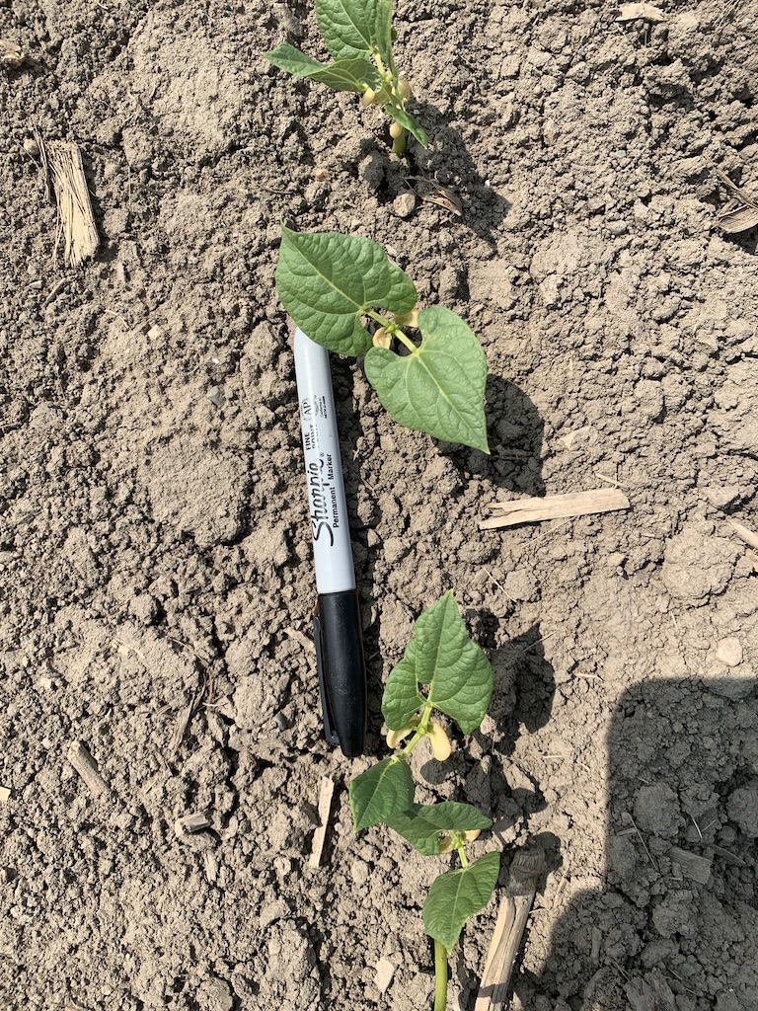
Planting Populations
One small plot trial was established to analyzed planting populations
20-inch rows
Black Bear black beans
73,000- 230,000 plants/A
Scott Bales- MSU Dry Bean Specialist

Slide 42
Planting Populations
250,000
200,000
150,000
Plants/A
100,000
50,000
0
0
10
20
30
40
Plot
Scott Bales- MSU Dry Bean Specialist

Slide 43
Planting Populations*
Yield (lb/A)
*Yields based on a one row harvest (25 ft² per plot)
Plants/A
Scott Bales- MSU Dry Bean Specialist

Slide 44
Planting Populations
Appears to be a “sweet spot” around 100,000-130,000 plants/A
Populations of 79,500-132,500 no effect on yield (Holmes and Sprague 2012)
Populations 102,786-142,823 no effect on yield (Varner 2012)
Scott Bales- MSU Dry Bean Specialist

Slide 45
Schindler Farms Steve Hoard Farms Dave’s Dirt Bednarski Farms Rader Farms Giles Farms J.A.D.E. Farms Randall Sturm Farms Buckley Creek Farms Atwater Farms Lakke & Ewald Farms
Thank you!
Scott Bales
Ph: (989) 262-8550
Email: balessco@msu.edu

