Slide 1
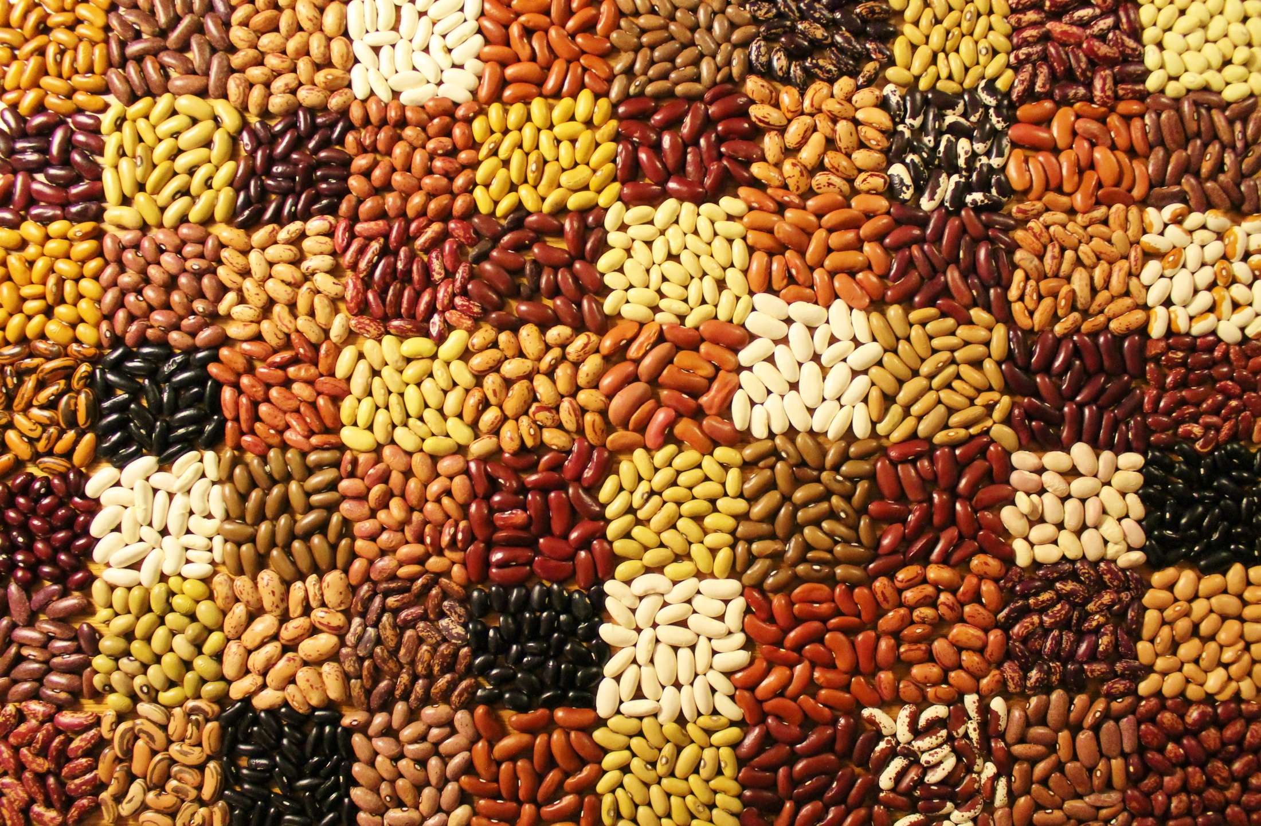
Breeding Beans in a Changing Environment
Jim Kelly
Evan Wright
Halima Awale Andrew Wiersma

Slide 2
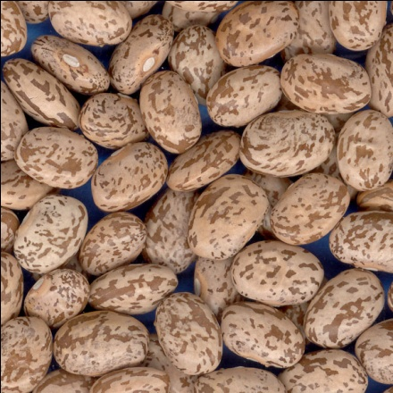
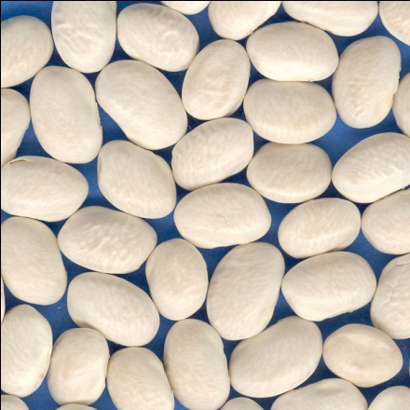
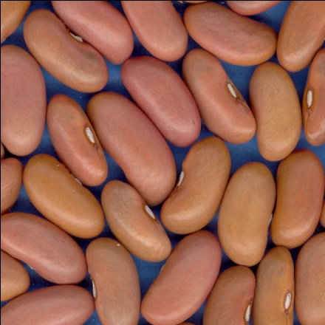
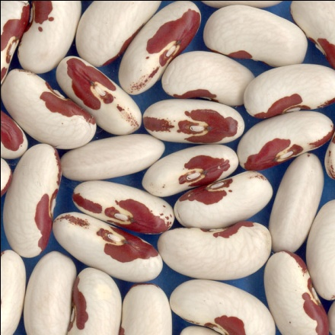
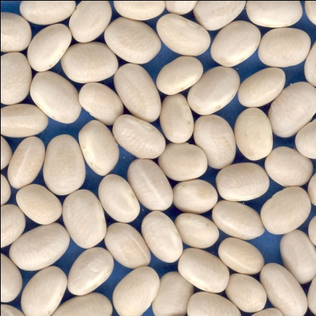
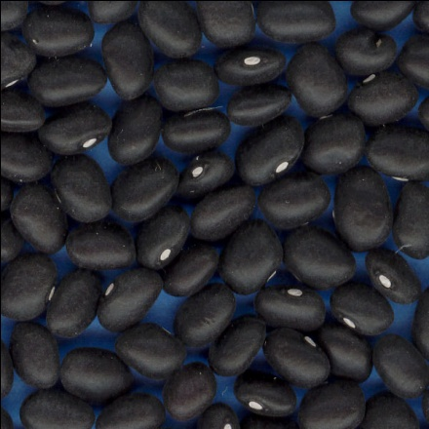
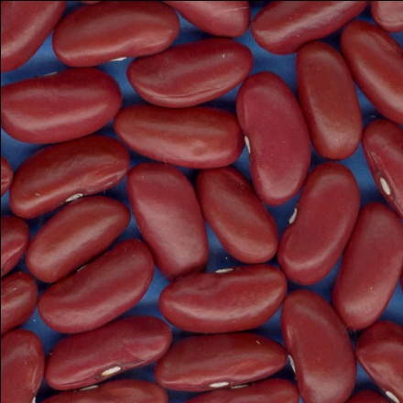
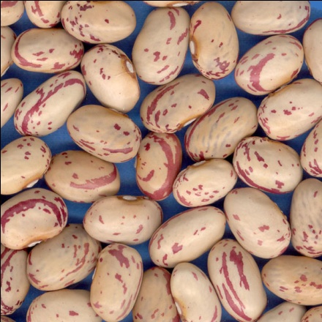
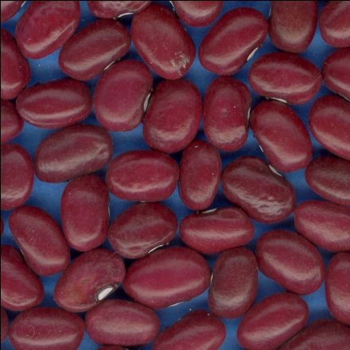
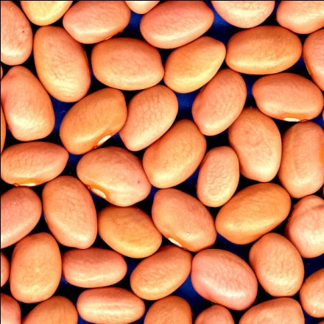
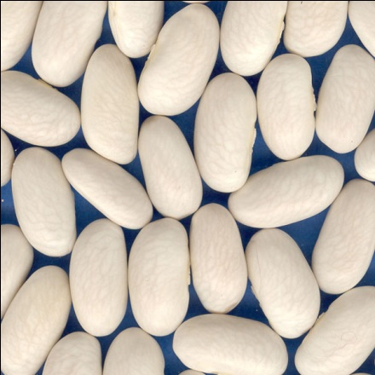
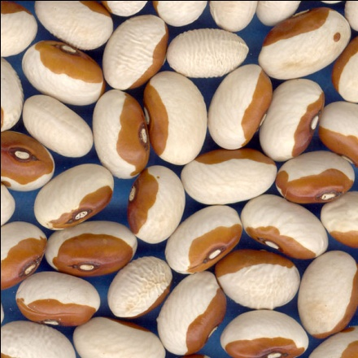
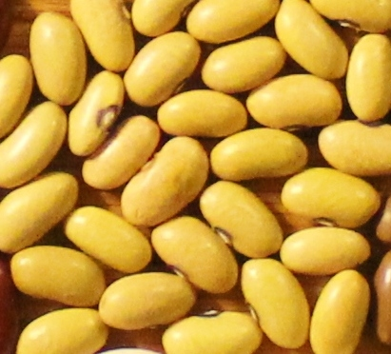
Durango
Meso
Jalisco
Middle American Gene Pool
Andean Gene Pool
Nueva
Gran
adaa
Pinto
Great Northern
Light Red Kidney
Soldier
Chi
l e
Peru
Navy
Black
Dark Red Kidney
Cranberry
Small Red
Pink
White Kidney
Yellow

Slide 3
KIDNEY BEAN TRIAL - 2019
VARIETY | YIELD CWT | 100 SEED | DAYS TO | DAYS TO | LODGING | HEIGHT | DES. | CBB
 | /ACRE | WT. (g) | FLOWER | MATURITY | (1-5) | (cm) | SCORE | (1-5)
K17704 | 39.7 | 64.0 | 36.0 | 100.0 | 1.0 | 50.3 | 5.0 | 1.0
K16911 | 37.1 | 67.7 | 39.0 | 95.0 | 1.0 | 48.3 | 6.0 | 3.0
OAC RACER | 37.1 | 70.9 | 36.0 | 93.0 | 1.0 | 46.0 | 4.3 | 1.0
SNOWDON | 35.1 | 70.8 | 35.0 | 93.0 | 1.0 | 47.0 | 5.0 | 3.0
RED CEDAR | 33.6 | 57.9 | 41.0 | 97.0 | 1.0 | 49.0 | 5.3 | 2.0
COHO | 33.3 | 52.8 | 43.0 | 102.0 | 1.3 | 51.3 | 5.0 | 2.0
MONTCALM | 33.2 | 61.9 | 41.0 | 102.0 | 1.0 | 49.3 | 3.7 | 3.0
CLOUSEAU | 32.5 | 68.8 | 38.0 | 96.0 | 1.0 | 49.0 | 4.0 | 5.0
RED HAWK | 31.6 | 61.2 | 37.0 | 97.0 | 1.0 | 49.0 | 4.0 | 4.0
ROSIE | 28.2 | 58.7 | 42.0 | 103.0 | 2.0 | 51.0 | 4.0 | 2.0
BELUGA | 27.7 | 64.5 | 43.0 | 105.0 | 1.0 | 51.0 | 3.7 | 4.0
BIG RED | 25.2 | 60.5 | 36.0 | 94.0 | 1.0 | 47.3 | 4.0 | 3.0
CHAPARRAL | 24.7 | 49.5 | 47.0 | 96.0 | 2.7 | 46.3 | 2.7 | 2.0
CELRK | 23.6 | 65.8 | 36.0 | 90.0 | 1.0 | 42.0 | 4.0 | 5.0
AAC Scotty | 19.8 | 65.2 | 36.0 | 95.0 | 1.0 | 45.7 | 3.7 | 1.0
CANDYCANE | 17.5 | 68.4 | 43.0 | 92.0 | 1.0 | 47.0 | 3.3 | 2.0
MEAN(42) | 30.8 | 61.8 | 40.1 | 97.7 | 1.3 | 49.0 | 4.4 | 2.4
LSD(.05) | 3.9 | 3.5 | 2.3 | 2.9 | 0.5 | 1.9 | 0.9 | -
CV% | 10.8 | 4.8 | 3.4 | 2.2 | 26.6 | 2.9 | 15.4 | 47.6

Slide 4
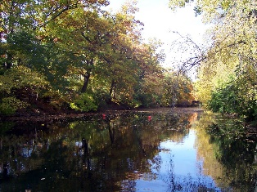
Dark Red Kidney Bean Yields 2011-2019(cwt/acre) RED CEDAR
Locations | Red Cedar | Red Hawk | Montcalm | Talon | Mean
22 | 28.9 | 28.3
20 | 28.8 |  | 26.5
16 | 28.6 |  |  | 27.0
25 | 28.4 |  |  |  | 28.1
Yield Percent | 100 | 98 | 92 | 95 | 99

Slide 5
Dark Red Kidney Bean Traits
Trait | Red Cedar | Red Hawk | Montcalm | Talon
Flower | 40 | 39 | 40 | 42
Maturity | 101 | 100 | 104 | 102
Height | 48 | 48 | 48 | 48
Lodging | 1.8 | 1.4 | 1.9 | 1.8
Seed Size | 55.8 | 59.5 | 61.2 | 57.8
CBB (1-5) | 1.5 | 2.5 | 3.0 | 3.0
Anthracnose | R | R | R | R
Canning (1-5) | 3.3 | 3.8 | 3.5 | 2.8

Slide 6
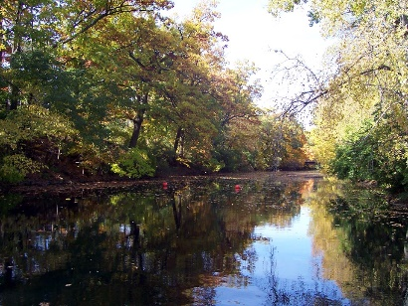
RED CEDAR DARK RED KIDNEY BEAN
Red Cedar has been tested as K11306 for 9 years (2011-19) across 25 locations across N. America
RED CEDAR yielded 28.4 cwt/acre
Outyielded Red Hawk by 2%; Montcalm by 8%
Good level of lodging resistance
Partial resistance to root rots, CBB & brown spot
Seed size smaller than Red Hawk
Uniform dry down compared to Montcalm
RED CEDAR has good canning quality equivalent to Montcalm & Red Hawk

Slide 7
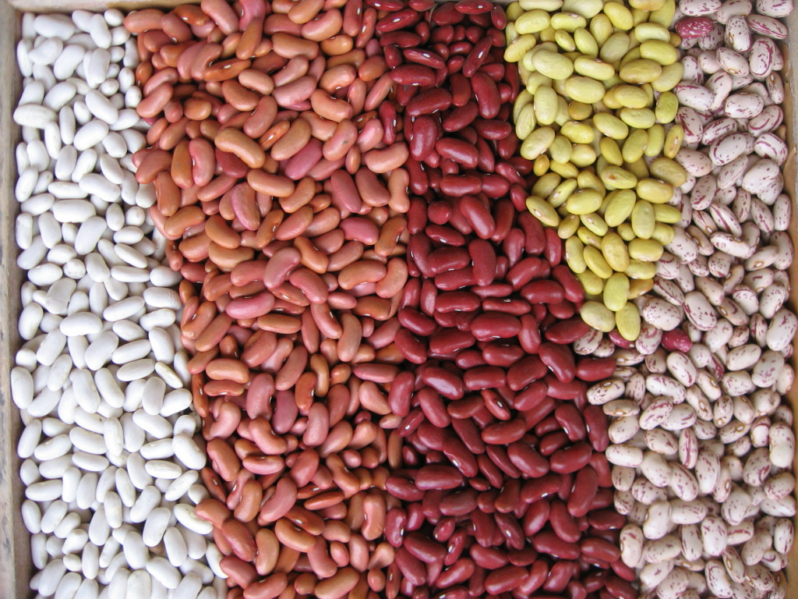
Development of COHO LRK
RED CEDAR DRK
K11916 WK
PP, rkrk
pp, RkRk
K15601 – COHO LRK
PP, RkRk

Slide 8
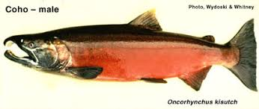
Light Red Kidney Bean Yields 2015-2019 (cwt/acre) COHO
Location | Coho | Clouseau | CELRK | Rosie | Big Red | Inferno
14 | 31.2 | 28.8 | 25.6
12 | 31.6 |  |  |  | 27.2
10 | 29.8 |  |  | 29.9 |  | 31.1
Yield Percent | 100 | 92 | 82 | 92 | 86 | 104
NEW @ MSU

Slide 9
Light Red Kidney Bean Traits
Trait | Coho | Clouseau | CELRK | Inferno
Flower | 38 | 36 | 34 | 40
Maturity | 99 | 97 | 94 | 105
Height | 52 | 49 | 45 | 54
Lodging | 1.5 | 1.0 | 1.0 | 3.0
Seed Size | 55.0 | 71.8 | 74.4 | 61.3
CBB (1-5) | 1.5 | 4.0 | 4.0 | 2.7
Anthracnose | R | R | R | R
Canning (1-5) | 4.0 | 4.0 | 3.7 | 2.6

Slide 10
Canning Quality Light Red Kidneys

Slide 11
COHO LIGHT RED KIDNEY BEAN
COHO has been tested for 5 years (2015-19) as K15601 across 14 locations in Michigan
Coho yielded 31.2 cwt/acre
Outyielded Clouseau by 8%; CELRK by 18%
Good level of lodging resistance
Partial resistance to root rots, CBB & brown spot
Seed size smaller than Clouseau
Uniform dry down compared to Inferno
Coho retains pink color following harvest and storage and has good canning quality equivalent to Clouseau

Slide 12
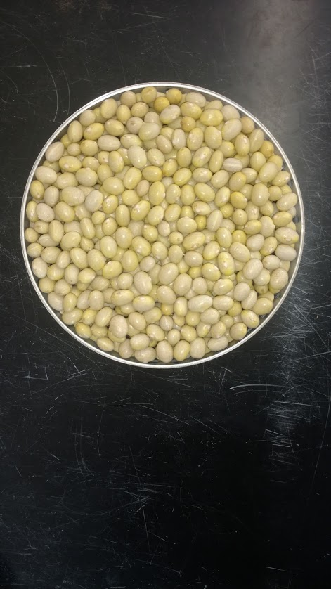
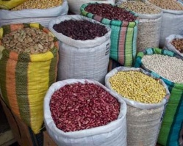
Development of Y16507 YELLOW
PR1146-123 CANARIO
Y11405 AZP
2013
RES. BCMV
SUS. BCMV
2016
Y16507 YELLOW

Slide 13
Yellow Bean Yields 2016-2019 (cwt/acre) Y16507
Locations | Y16507 | Patron | SVS-0863 | Mean
6 | 24.6 | 27.3
4 | 31.3 |  | 32.5
8 | 25.8 |  |  | 27.2
Yield Percent | 100 | 111 | 104 | 106
T-Test | P>=0.05 | 0.44678 | 0.81245 | 0.53088

Slide 14
Yellow Bean Agronomic Traits
Trait | Y16507 | Patron | SVS-0863
Flower | 41 | 43 | 41
Maturity | 94 | 97 | 96
Height | 47 | 47 | 48
Lodging | 1.8 | 2.4 | 2.8
Agronomic | 4.9 | 4.1 | 4.0
Seed size | 46.0 | 50.8 | 47.5
Canning(1-5) | 3.5 | 4.2 | 3.4

Slide 15
YELLOW BEAN DISEASE DATA
Cultivars | BCMV | Anthracnose |  | Common Bacterial Blight | White Mold
 | NL 3 | Race 2 | Race 7 | Local isolates | %
Y16507 | R | S | S | S | 20
PATRON | R | S | S | S | --
SVS-0863 | R | S | S | S | 80

Slide 16
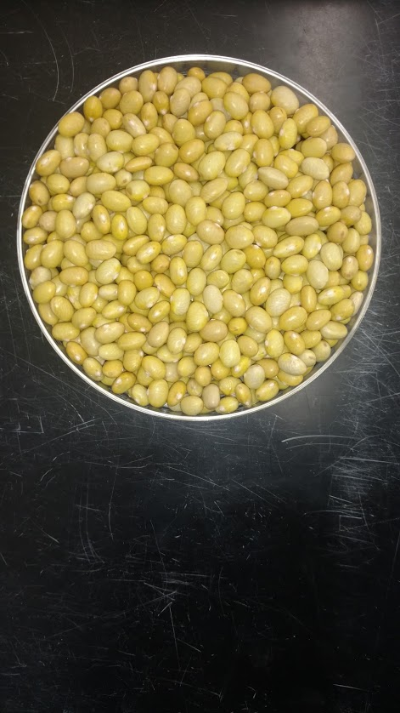
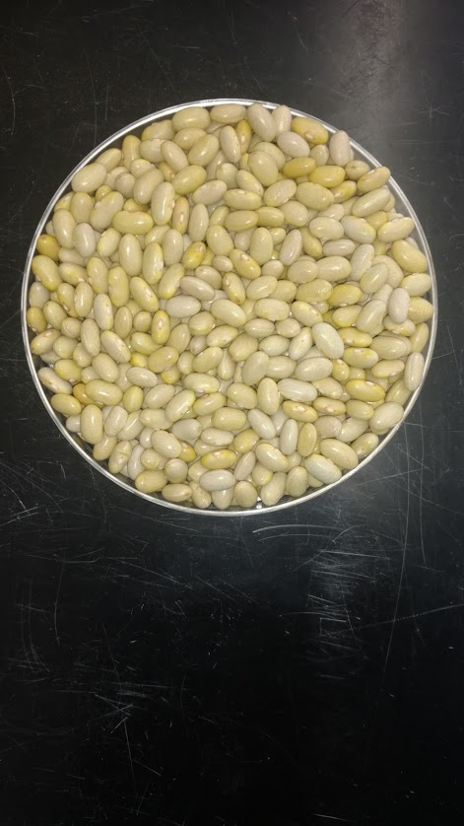
Yellow Bean Varieties – AZP Azufrados – Peruanos -Mayacobas
PATRON
Y16507
SVS-0863

Slide 17
Y16507 Yellow Bean
Y16507 has been tested for 4 years years (2016-19) across 8 locations in Michigan
Y16507 yielded 25.8 cwt/acre
Uniform dry down at Maturity
Upright bush habit with improved level of lodging resistance over current varieties
Increased tolerance to white mold
Seed size equivalent to other Yellow varieties
Superior yellow seed coat color at Maturity compared to other varieties
Canning quality equivalent to other Yellow varieties
Proposed name of YELLOWSTONE

Slide 18
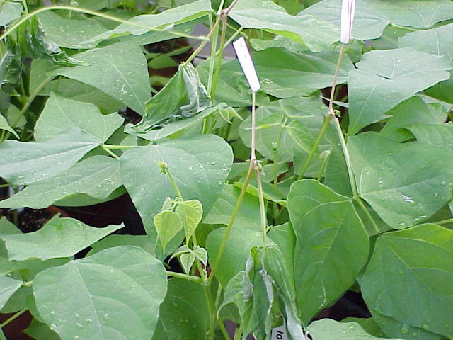
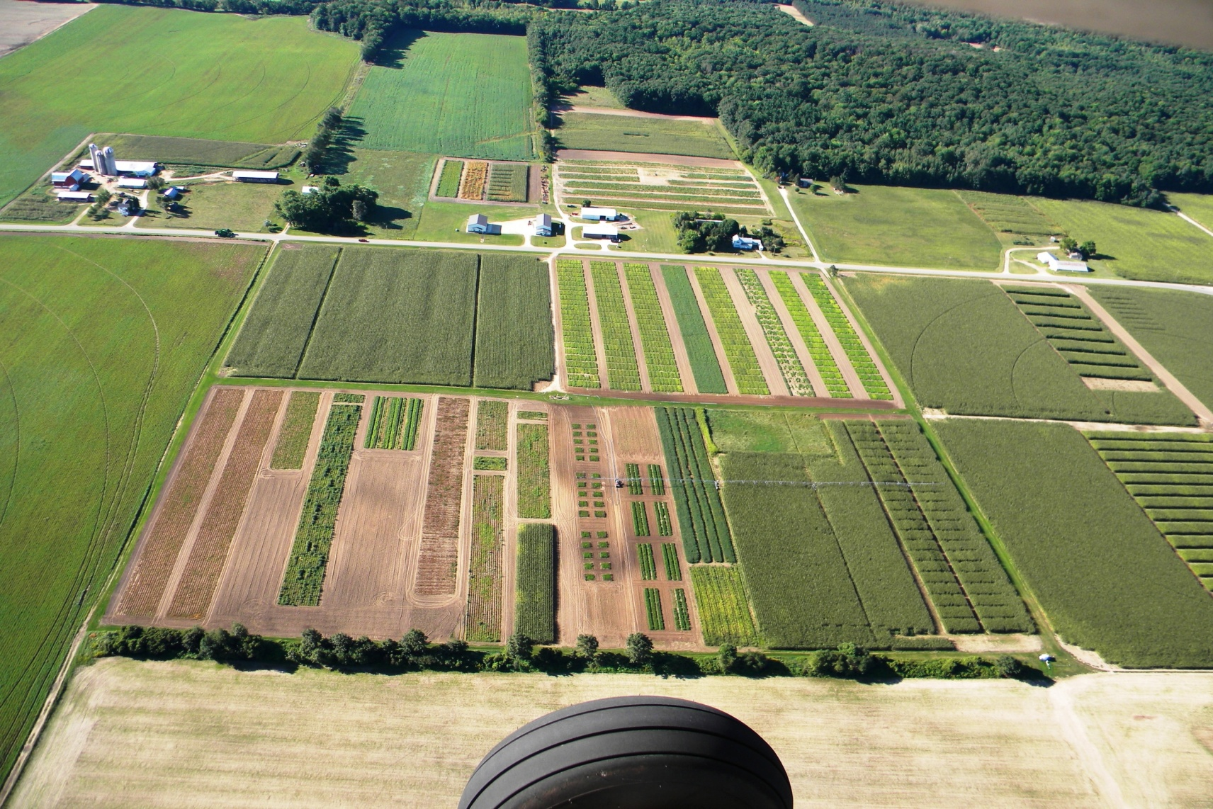
Screening for White Mold – Montcalm Research Farm

Slide 19
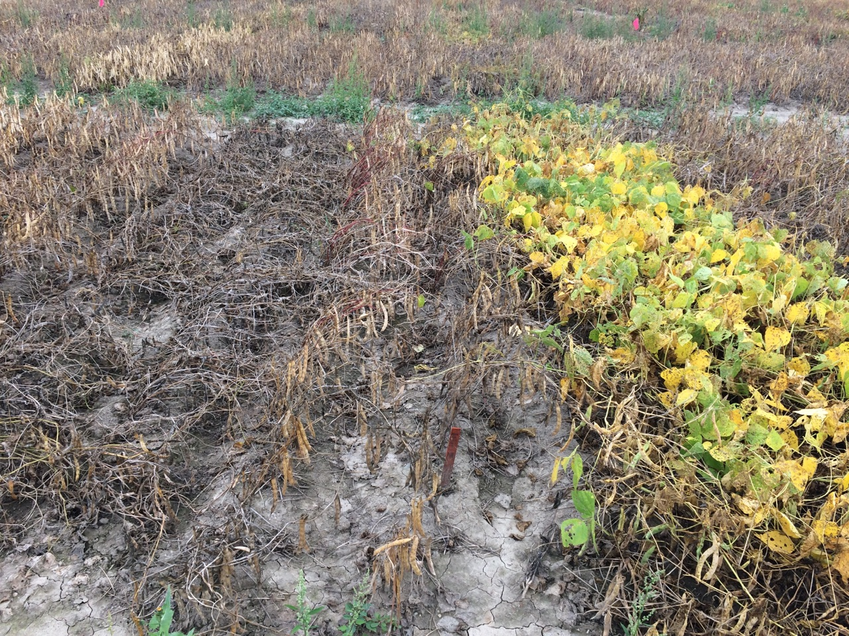

Slide 20
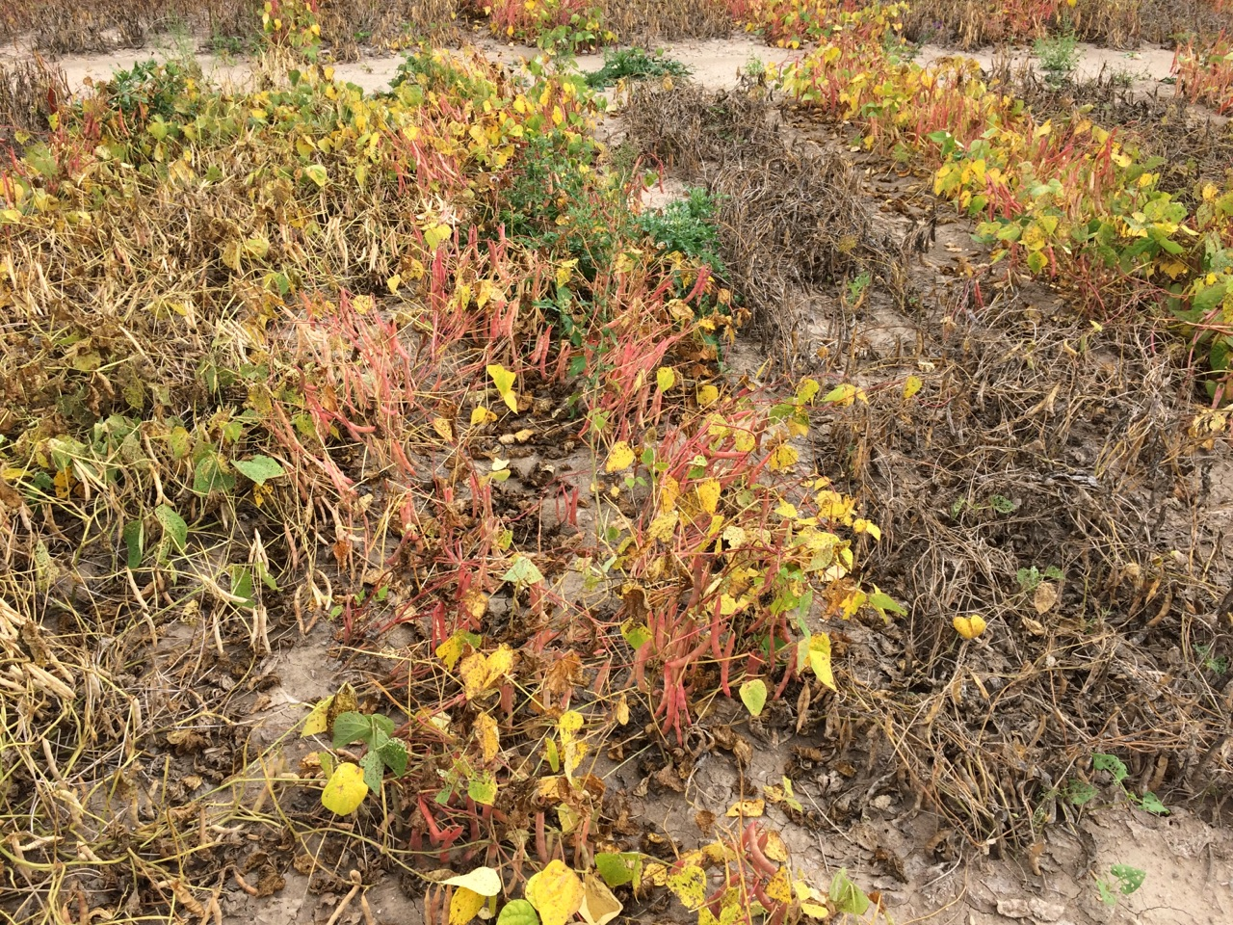

Slide 21
White Mold Trials - 2019
VARIETY | YIELD | 100 SEED | DAYS | DAYS TO | LODGE | HEIGHT | SCOR | WM | WM
 | CWT/A | WT. (g) | FLOWR | MATURE | (1-5) | (cm) |  | (1-9) | %
G17410 | 44.7 | 38.7 | 44.0 | 102.0 | 1.0 | 53.3 | 5.3 | 2.3 | 25.9
R17605 | 42.0 | 36.3 | 50.0 | 102.0 | 2.3 | 51.3 | 4.0 | 5.3 | 59.2
P17510 | 39.5 | 43.8 | 47.0 | 98.0 | 2.0 | 52.3 | 4.3 | 5.7 | 63.0
CAYENNE | 39.2 | 37.3 | 48.0 | 97.0 | 2.3 | 51.3 | 4.3 | 3.7 | 40.7
R17603 | 38.0 | 37.6 | 50.0 | 101.0 | 1.7 | 52.3 | 5.3 | 3.7 | 40.7
G16351 | 36.2 | 38.6 | 46.0 | 96.0 | 2.0 | 52.7 | 4.0 | 7.0 | 77.8
N18122 | 36.2 | 26.3 | 49.0 | 102.0 | 1.3 | 57.0 | 6.0 | 3.7 | 40.7
P16901 | 36.1 | 41.5 | 50.0 | 97.0 | 1.7 | 51.0 | 5.0 | 5.0 | 55.5
R17604 | 33.0 | 34.7 | 50.0 | 100.0 | 2.0 | 51.7 | 4.7 | 5.0 | 55.5
ZENITH | 31.1 | 24.2 | 47.0 | 94.0 | 1.0 | 51.0 | 5.3 | 5.3 | 59.3
B16504 | 30.9 | 21.2 | 49.0 | 98.0 | 1.0 | 53.3 | 5.0 | 4.3 | 48.1
PHORN | 28.0 | 36.6 | 44.0 | 91.0 | 1.3 | 47.7 | 5.0 | 3.0 | 33.3
B18504 | 27.6 | 22.7 | 49.0 | 98.0 | 1.3 | 50.0 | 4.7 | 4.0 | 44.4
MERLIN | 25.5 | 20.0 | 46.0 | 99.0 | 2.0 | 49.3 | 4.0 | 4.7 | 51.9
BUNSI | 16.9 | 21.6 | 44.0 | 94.0 | 3.7 | 43.7 | 3.0 | 6.3 | 70.4
G122 | 12.4 | 44.9 | 48.0 | 106.0 | 1.0 | 46.7 | 2.3 | 2.0 | 22.2
BERYL | 12.4 | 32.8 | 43.0 | 91.0 | 5.0 | 40.0 | 2.0 | 8.7 | 96.3
MEAN(32) | 30.0 | 31.6 | 47.2 | 96.9 | 1.7 | 50.5 | 4.5 | 4.6 | 50.7
LSD(.05) | 6.5 | 2.3 | 1.9 | 2.7 | 0.6 | 2.7 | 0.9 | 2.6 | 29.3
CV% | 15.9 | 5.4 | 2.4 | 2.0 | 27.2 | 3.9 | 14.1 | 42.4 | 42.4

Slide 22
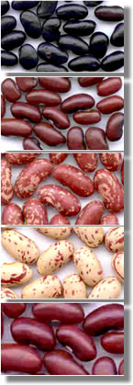
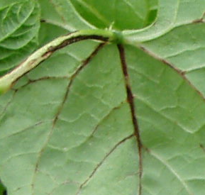
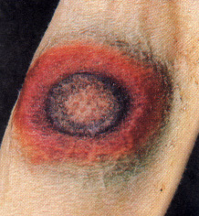
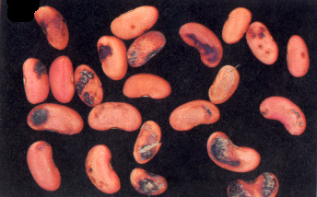
Figure 1. Anthracnose symptoms on bean leaves, pods and seeds.

