Slide 1


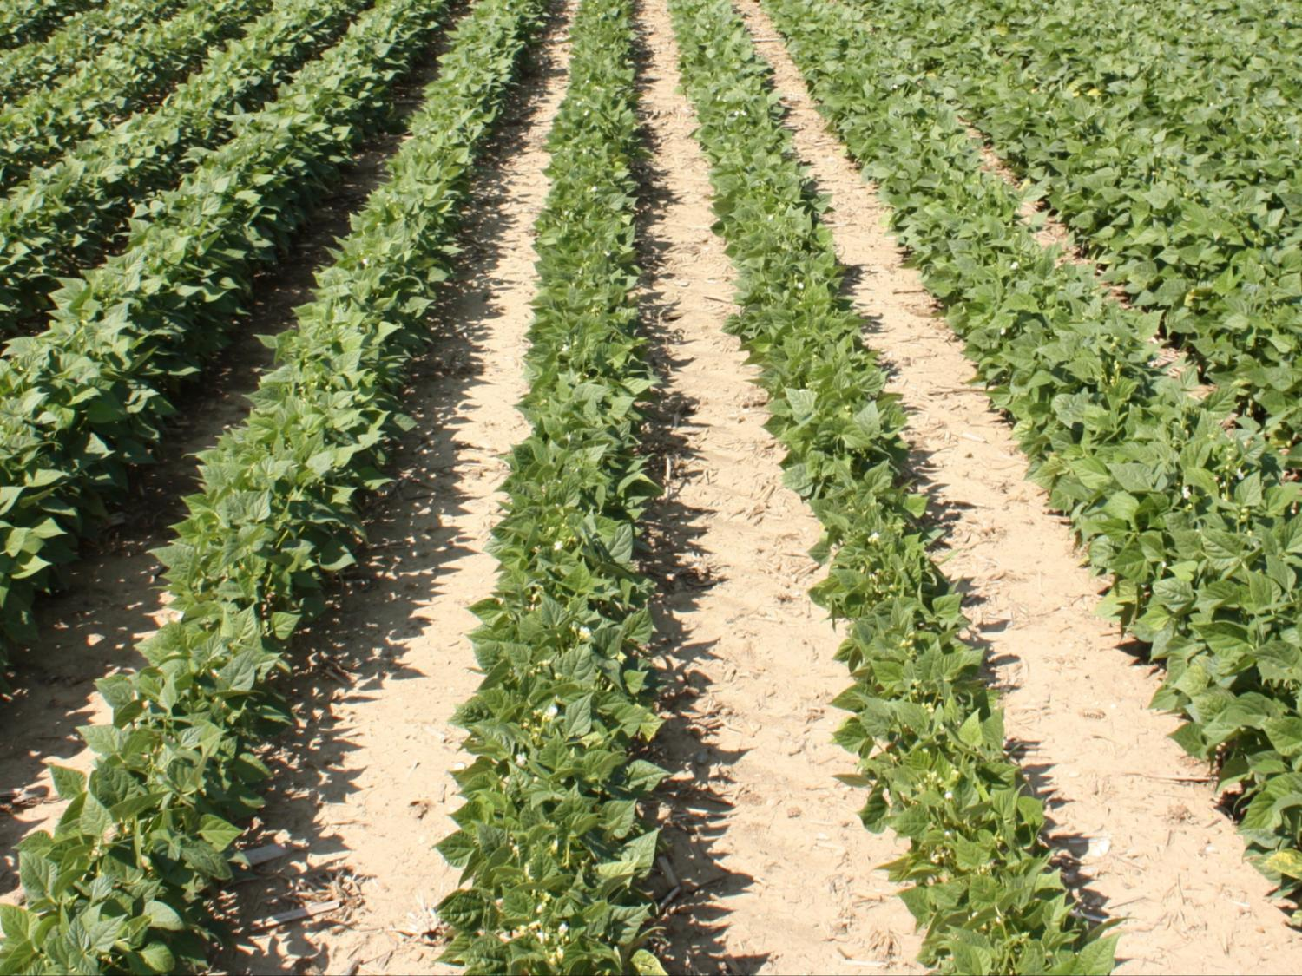



Dry Bean Root Rot Disease Research
Martin Chilvers
Dep. of Plant, Soil and Microbial Sciences
chilvers@msu.edu @MartinChilvers1
517-353-9967
www.fieldcroppathology.msu.edu

Slide 2
Identifying Michigan’s dry bean pathogens
2014-2018
8 counties surveyed
  Montcalm Research Station and Saginaw Valley Research and Extension Farm sampled every year
  Commercial fields
Collected symptomatic dry bean roots
Surveyed County

Slide 3
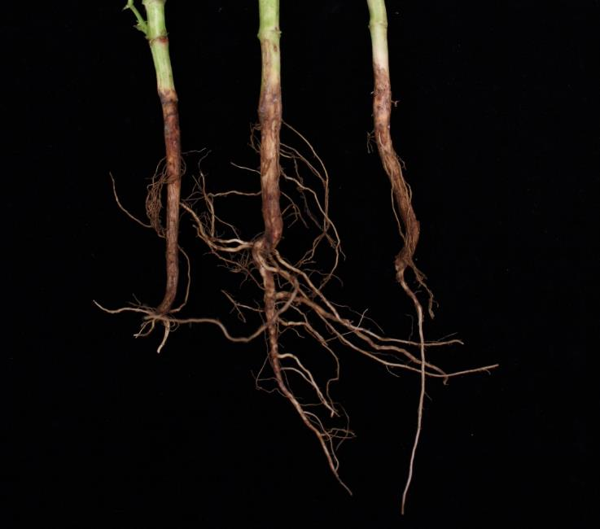
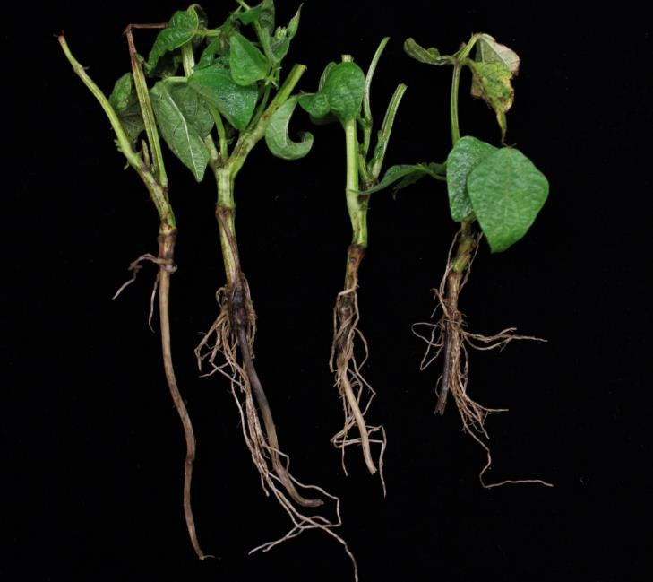
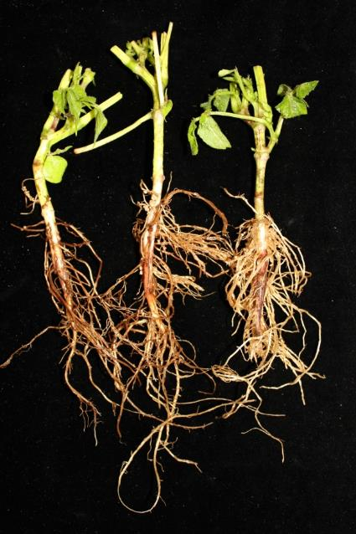
Dry bean root rot pathogens in Michigan
Year | Fusarium (%) | Rhizoctonia (%) | Oomycetes (%) | Total number
2014 | 38 | 42 | 20 | 139
2015 | 44 | 26 | 30 | 454
2016 | 63 | 21 | 16 | 71
2017 | 68 | 9 | 23 | 226
2018 | 74 | 15 | 11 | 144
Rhizoctonia
Fusarium
Pythium
Janette Jacobs/Kjersten Oudman

Slide 4
2019 dry bean root rot isolation results
Field Identification | No. of Samples | Bean Class | Rhizoctonia solani | Fusarium spp. | Fusarium solani clade 2 | oomycetes
SVRES-Frankenmuth | 10 | ? | 8/10 | 10/10 | 0/10 | 0/10
Rhode Farms-Hawkes | 15 | Red Kidney | 1/10 | 15/15 | 14/15 | 0/10
Alpena Co. | 5 | Navy | 3/5 | 4/5 | 1/5 | 0/5
Huron Co. | 5 | Black Bean | 4/5 | 5/5 | 0/5 | 0/5
The plant samples from all of the field locations with the exception of Rhode Farms displayed similar symptoms; internal vascular discoloration, lack of lateral roots, root death and early plant senescence.
  Rhizoctonia solani was consistently isolated from all three of these locations from symptomatic plant tissue.
  A typical variety of Fusarium spp. were also isolated from samples, however, there was not a single dominant species present. I did not consistently isolate Fusarium oxysporum that could potentially cause the vascular discoloration present.
  I also only recovered one Fusarium solani species complex clade 2 isolate from these three fields. This suggests that they are either newer fields for bean production or are on a long rotation.
Rhodes Farms plant samples exhibited classic Fusarium root rot symptoms.
  Rhizoctonia solani was recovered from only one plant sample and from a single lesion located just above the soil line on the stem.
  A plethora of Fusarium spp with various morphologies and pigmentation were isolated from infected plant tissue. In addition, 14/15 plant samples produced the typical sporodochia associated with Fusarium solani species complex clade 2.
Notes:
The plant samples from all of the field locations with the exception of Rhode Farms displayed similar symptoms; internal vascular discoloration, lack of lateral roots, root death and early plant senescence.
Rhizoctonia solani was consistently isolated from all three of these locations from symptomatic plant tissue.
A typical variety of Fusarium spp. were also isolated from samples, however, there was not a single dominant species present. I did not consistently isolate Fusarium oxysporum that could potentially cause the vascular discoloration present.
I also only recovered one Fusarium solani species complex clade 2 isolate from these three fields. This suggests that they are either newer fields for bean production or are on a long rotation.
Rhodes Farms plant samples exhibited classic Fusarium root rot symptoms.
Rhizoctonia solani was recovered from only one plant sample and from a single lesion located just above the soil line on the stem.
A plethora of Fusarium spp with various morphologies and pigmentation were isolated from infected plant tissue.
In addition, 14/15 plant samples produced the typical sporodochia associated with Fusarium solani species complex clade 2.

Slide 5
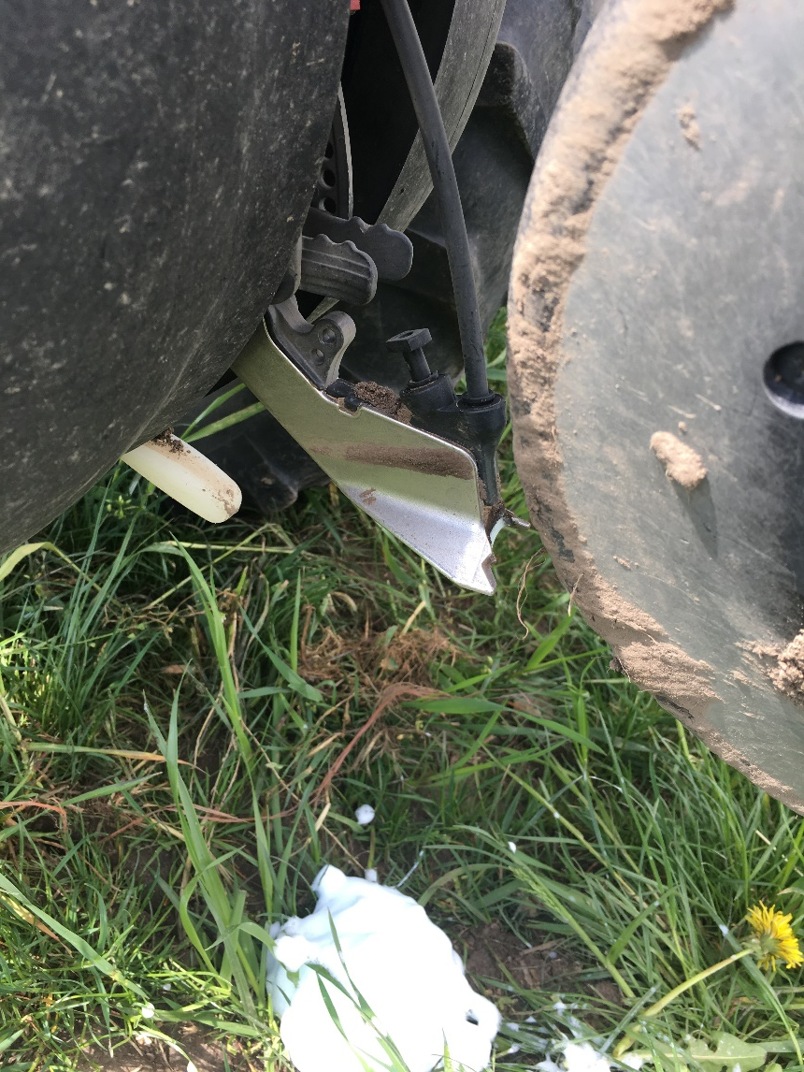
Significance of root rot disease surveys
Identify what is causing the problem (pathogens)
Pathogens can be characterized
Screen germplasm for resistance to pathogens
Screen seed treatments for efficacy
  w/ companies to identify new products/combinations
  Application technologies i.e. in-furrow applications

Slide 6
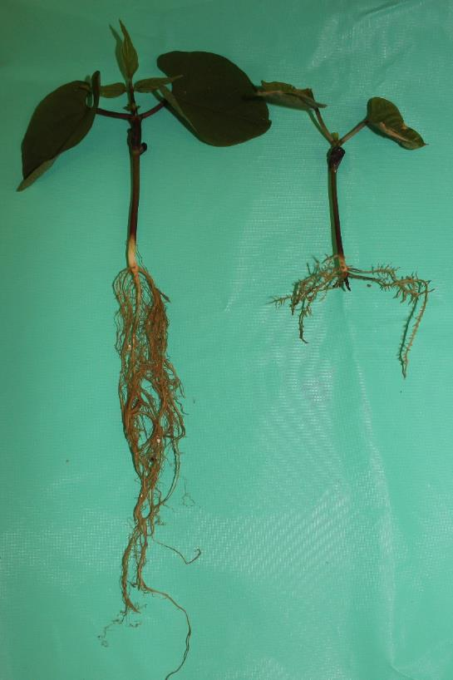
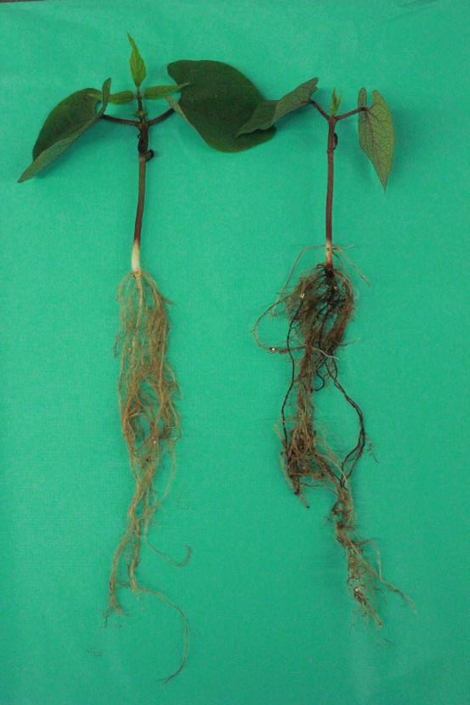
Characterization of Fusarium root rot species
Control
FSSC
Control
FOSC
Fusarium brasiliense
Fusarium oxysporum
Rotting and lesions on taproot, but little reduction in root mass
  Drastic reduction in root mass

Slide 7
Stand reduction – inoculated field trials
Field data confirms greenhouse screens
F. brasiliense in F. solani
2018 field trial

Slide 8
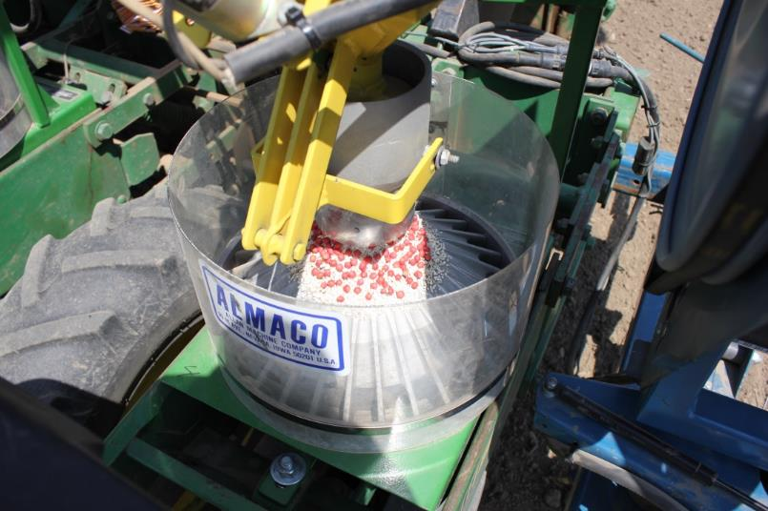
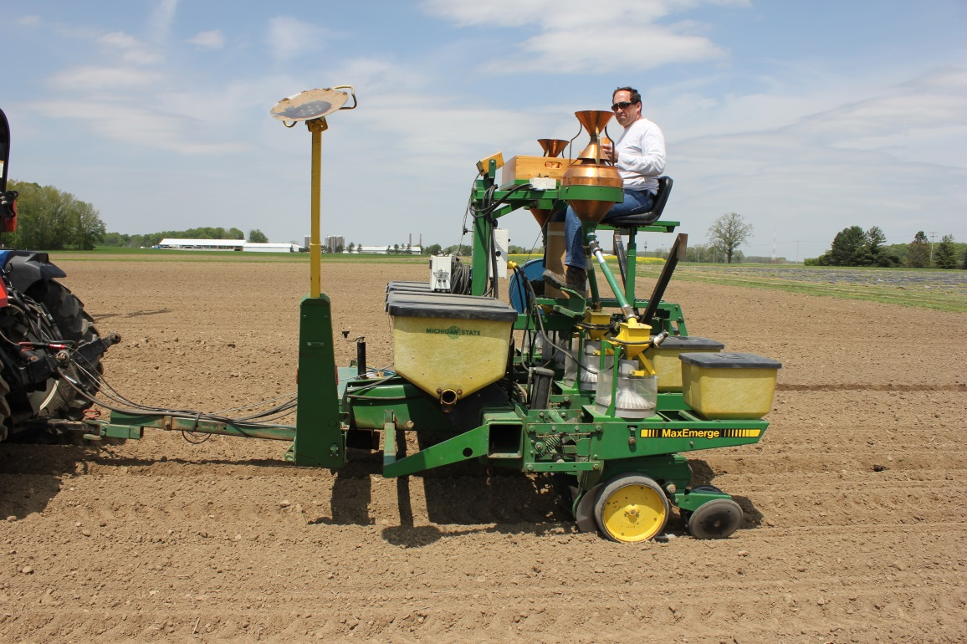
Field trial testing
Germplasm for root rot resistance Dr. Kelly and Dr. Cichy
New seed/in furrow treatments
Adam Byrne/John Boyse

Slide 9
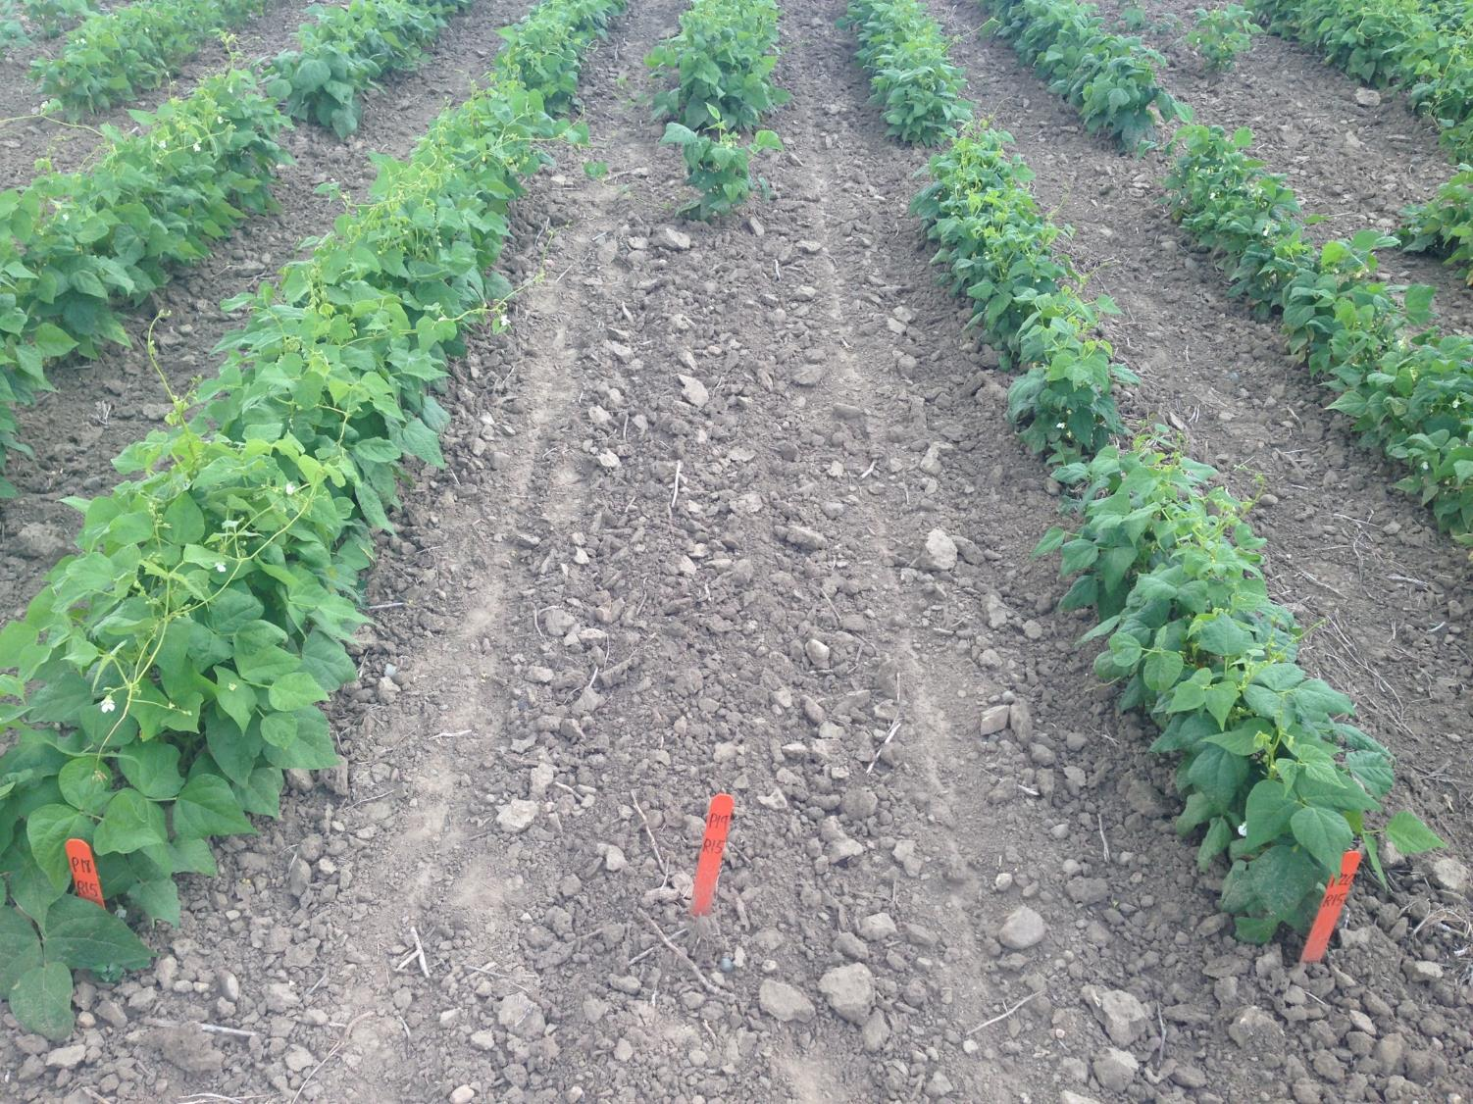
Example of germplasm screening
Rhizoctonia field inoculation

Slide 10

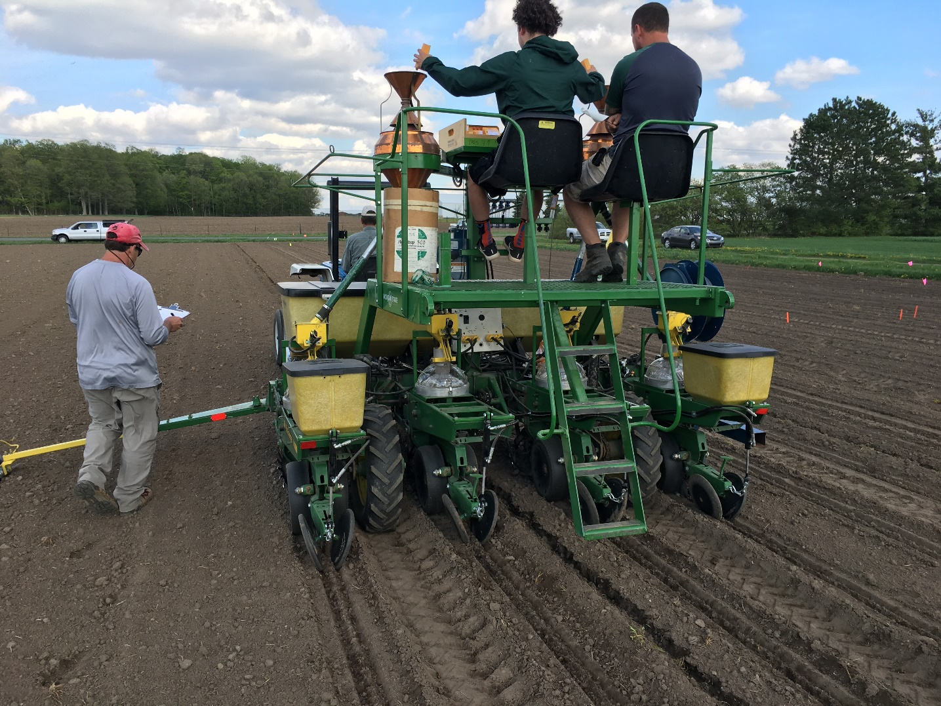

In-Furrow trials 2019
Zenith planted at 78,000/A
Ethos XB & Ethos 3D = Bacillus amyloliquefaciens + Bifenthrin
Capture LFR & Capture 3RIVE3D = Bifenthrin (pyrethroid insecticide)
Notes:
Bacillus amyloliquefaciens demonstrates antifungal properties

Slide 11
In-Furrow trials 2019
Ethos XB & Ethos 3D = Bacillus amyloliquefaciens + Bifenthrin
Capture LFR & Capture 3RIVE3D = Bifenthrin (pyrethroid insecticide)
Fusarium inoculated
non-inoculated
Fusarium inoculated
non-inoculated
Seeded at 78k/A
P<0.0001
No statistical difference
Notes:
Bacillus amyloliquefaciens demonstrates antifungal properties

Slide 12
In-Furrow trials 2019
Ethos XB & Ethos 3D = Bacillus amyloliquefaciens + Bifenthrin
Capture LFR & Capture 3RIVE3D = Bifenthrin (pyrethroid insecticide)
Fusarium inoculated
non-inoculated
Fusarium inoculated
non-inoculated
Seeded at 78k/A
P<0.0001
No statistical difference
Notes:
Bacillus amyloliquefaciens demonstrates antifungal properties

Slide 13
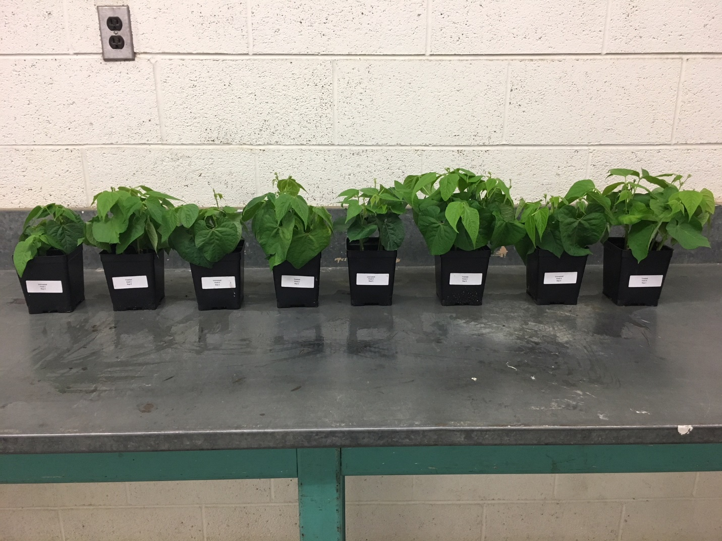
Importance of crop rotation and seed treatment
Short rotation – 2yr
Long rotation – 4yr
ST- ST+ ST- ST+ ST- ST+ ST- ST+
Cranberry beans “Etna”; GroWest Premium Western Seed
Seed Treatment: Maxim, Apron XL, Dynasty, Rancona, Vibrance, and Cruiser
Rotation offers plant health advantage
Seed treatments also result in healthier plants

Slide 14
White mold management
Can we use Sporecaster for dry beans?
Irrigated soybean and dry bean may require additional data sets
Can we use a PPO inhibitor fungicide to help manage white mold, such as Cobra in soybean?

Slide 15
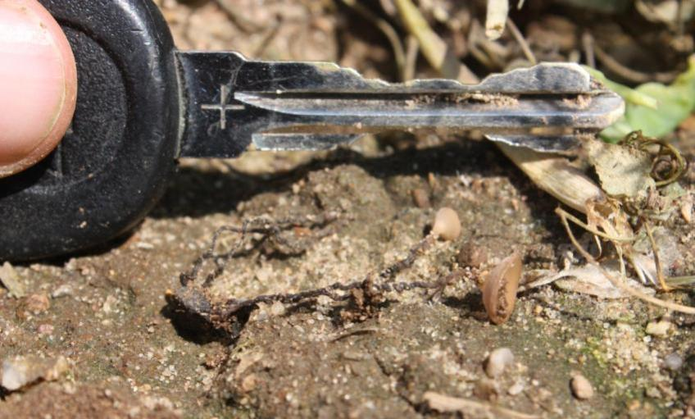
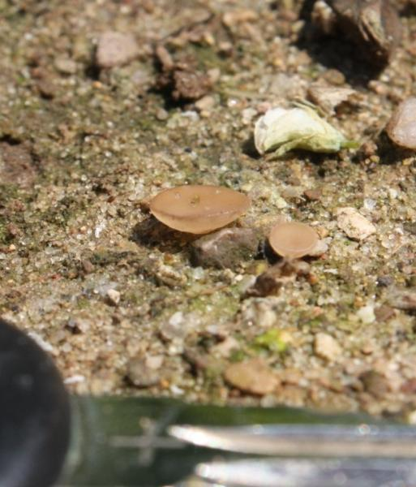
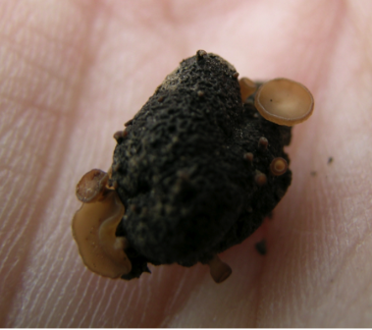
White mold mushrooms

Slide 16
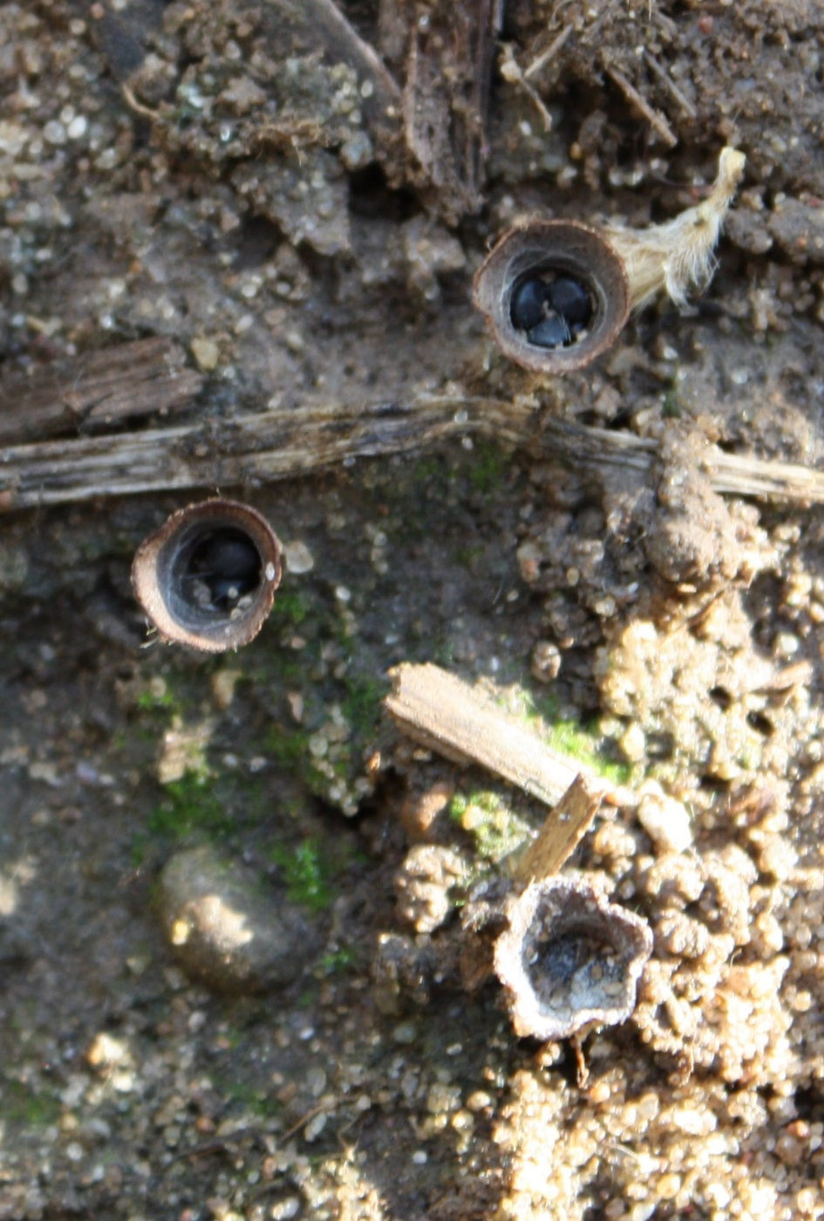
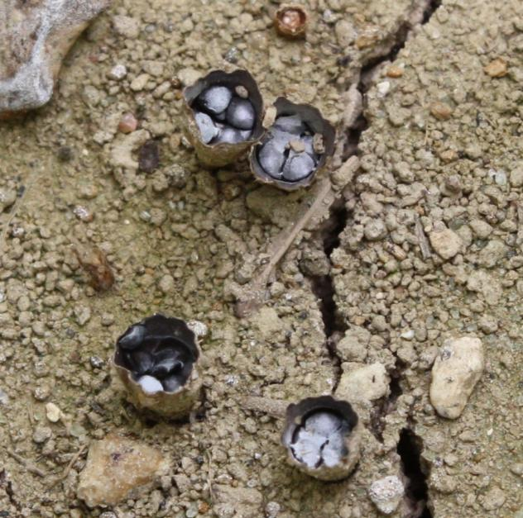
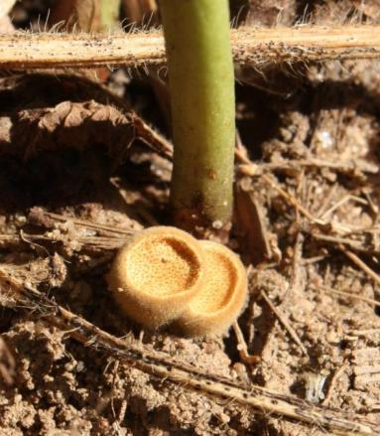
Not White Mold
Bird’s nest fungi

Slide 17
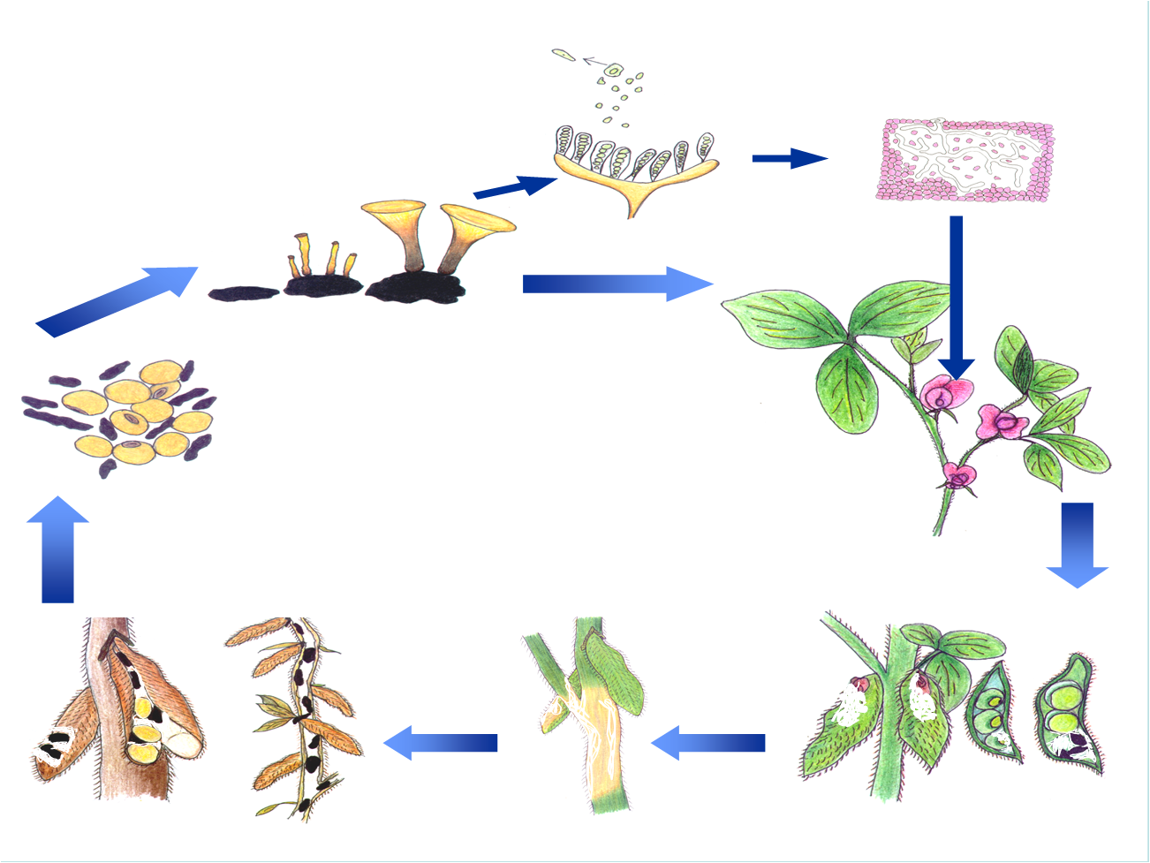
Drawing: Marilyn Hovius
Ascospore dispersal
Canopy closure
Soilborne sclerotia
Disease Cycle
Disease and sclerotia development occur from R3 to R8 growth stages
Slide Courtesy of Craig Grau
Notes:
17
17

Slide 18

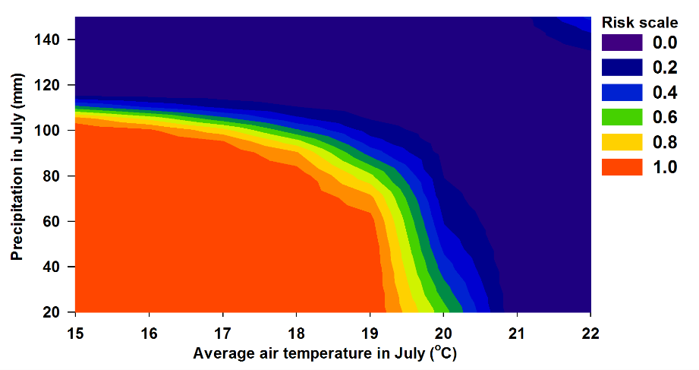
Soybean white mold risk factors
MSU Sanilac performance trial data (2000 to 2014)
Avg. temp. in July <67F
Precip. July >0.78” <4.3”
No effect of MG across years
[Sclerotia sampling]
Fall et al. Phytopathology 108:469

Slide 19
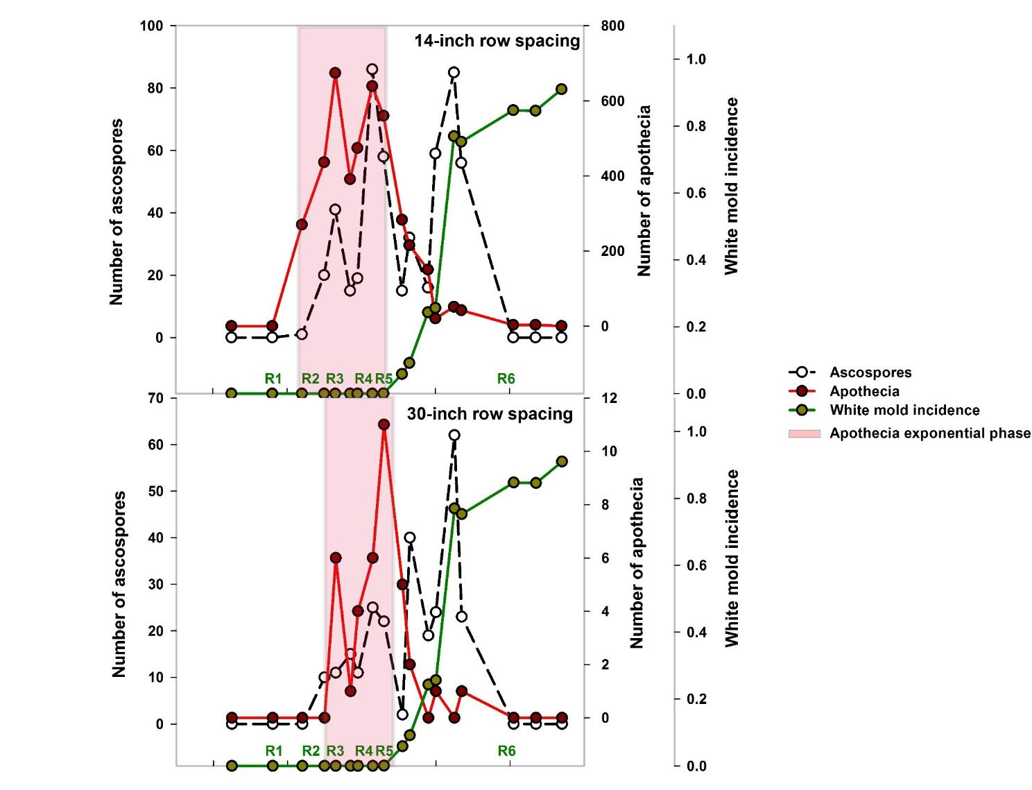
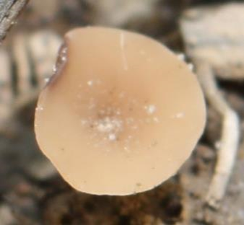
2015 Montcalm
60X more apothecia in 14” vs 30”
60X
more apothecia
Fall et al. 2018 Plant Disease

Slide 20
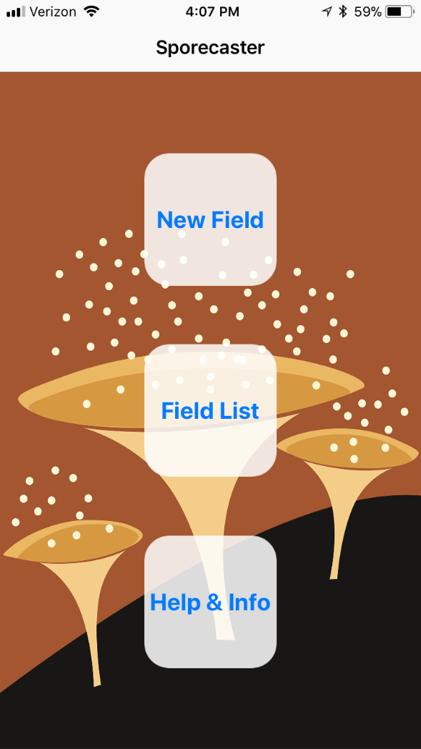

Slide 21
White mold management
Can we use Sporecaster for dry beans?
Irrigated soybean and dry bean may require additional data sets
Can we use a PPO inhibitor fungicide to help manage white mold, such as Cobra in soybean?

Slide 22
2016 Soyben white mold trial 1 (disease score)

Slide 23
2016 soybean white mold trial 1 (yield bu/A)

Slide 24

2016, Cadet on soybean white mold - Disease

Slide 25
2016, Cadet on soybean white mold - Yield

Slide 26


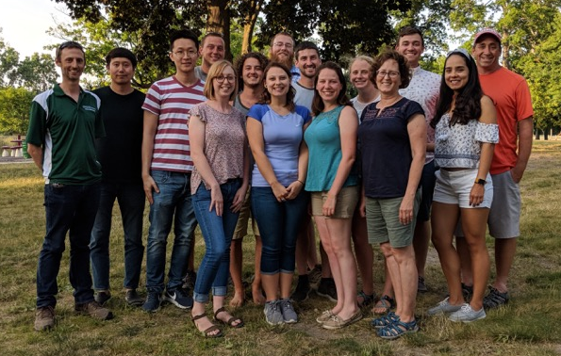

Acknowledgements

