Slide 1
Drought Resilience in Michigan Dry Beans
James DeDecker, Jim Kelly, Andrew Wiersma
MSU Upper Peninsula Research and Extension Center
dedecke5@msu.edu

Slide 2
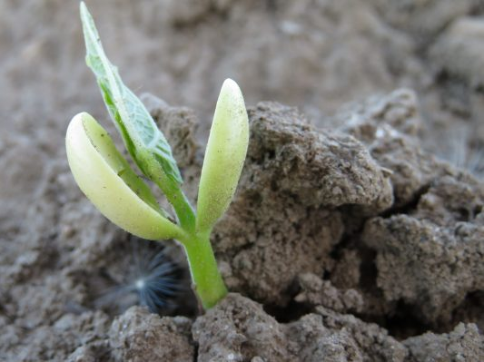
Overview
Climate Change Primer
Precipitation and Drought
PRI Drought Resilience Project
GLISA Climate Impact Scenarios Project

Slide 3
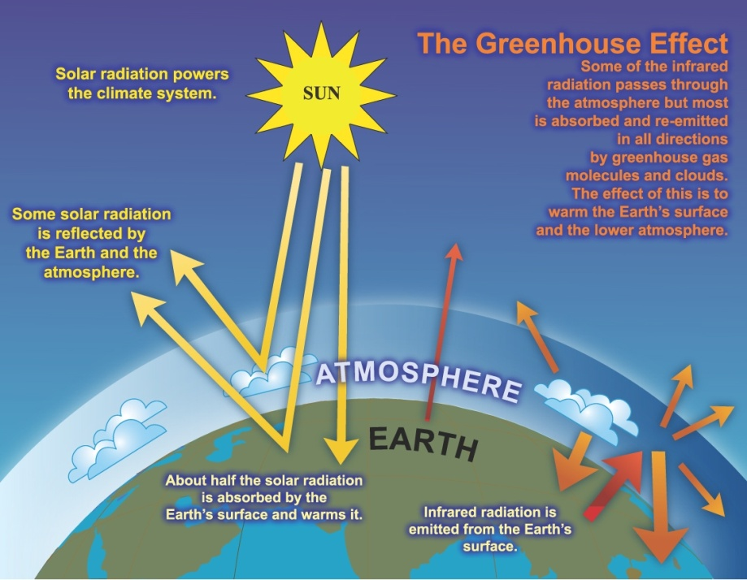
(EPA, 2007)
Notes:
The greenhouse effect warms the Earth (and other planets) in a similar way, although it’s not exactly the same. The Earth’s transparent atmosphere lets sunlight pass through to warm the ground and the oceans. The Earth’s warmed surface releases some of that heat in the form of infrared radiation (longer wavelength radiation)— a form of light, but invisible to human eyes.
This infrared light wants to keep on going, right back out into space, taking the warmth with it. But some gases in the atmosphere won’t let all the infrared radiation pass through. These “greenhouse gases” are very good at absorbing infrared light. These greenhouse gases then emits radiation back to the land and the oceans. So greenhouse gases act sort of (though not exactly) like the glass in the greenhouse. They let sunlight through on its way in from space, but intercept some of the infrared light on its way back out.
These greenhouse gases are carbon dioxide, nitrous oxide, methane, water vapor, ozone and halocarbons, all of which are naturally occurring except for halocarbons, which were used as coolants, solvents and refrigerants beginning in the 1930s. Over millennia, the Earth’s average surface temperature is correlated with the amount of greenhouse gases in the atmosphere. Historically, when greenhouse gas concentrations have been relatively high, so have the average surface temperatures.
The importance of this so-called “greenhouse effect” cannot be overstated. Without an atmosphere that acts as a blanket to absorb heat, the Earth would be almost 60 degrees Fahrenheit (F) cooler on average than it is now. For example, the moon, our nearest neighbor in the solar system, has surface temperatures ranging from 225 degrees F in the sun to a freezing -240 degrees F in the dark because it lacks an atmosphere. But as we’ll see in a minute, too many gases in the atmosphere can cause warming of the planet that is not beneficial to us.

Slide 4
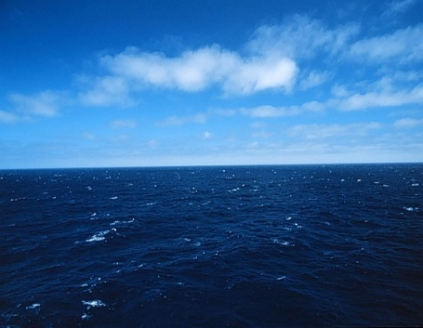
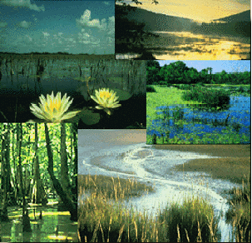
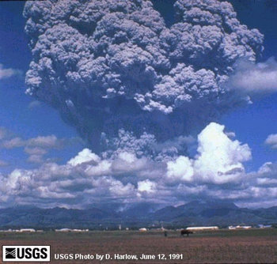
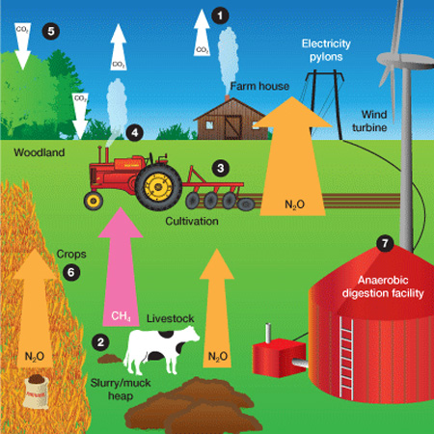
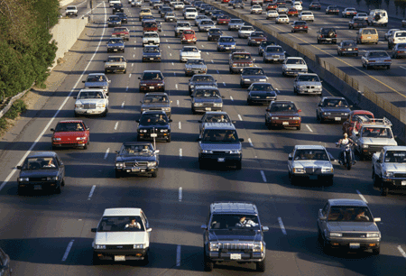
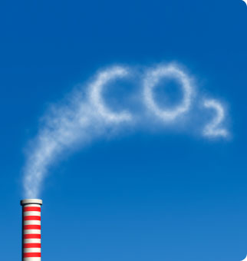
Sources of Greenhouse Gas
Natural sources
+
Source: EPA
Human (anthropogenic) sources
Notes:
The climate at a given location seems to be relatively stable, but it is ever-changing because of its dynamic nature and many components. Cause of climate change can be broadly categorized into two parts: 1) Natural Causes and 2) Human (Anthropogenic) Causes
Natural Causes: Any natural activity that emits greenhouse gases into the atmosphere are categorized as natural causes. Examples of natural causes as shown in the picture above are evapotranspiration from water bodies, plants, and trees. Water vapor that is emitted in the atmosphere from evapotranspiration is one of the most significant greenhouse gases. This process is natural on which humans have no control over. Another example is wetlands which is a primary source of methane gas emission due to the decomposition process. Volcanic eruption is another example of natural cause. When volcano erupts, aerosol particles spread into the atmosphere and creates a reflective shield which prevents radiation from coming towards the earth. Due to this natural process, we may observe somewhat cooling trend for a short time-period. However, other potential greenhouse gases that are emitted in volcano such as carbon dioxide, may in longer timeframe contribute towards warming trend. These are some of the examples of natural causes of climate change.
Human Causes: The Intergovernmental Panel on Climate Change (known by the acronym “IPCC”) is a group of scientists who issue comprehensive assessments on climate science. According to the IPCC 2007 report, we know that humans are impacting the climate. Any human activities that is resulting in greenhouse gas emissions into the atmosphere is categorized under this criteria. Some examples of human causes are energy production, fossil fuel burning, transportation, agricultural practices such as fertilization and livestock production. We’ll talk more about agriculture’s role in this later.

Slide 5
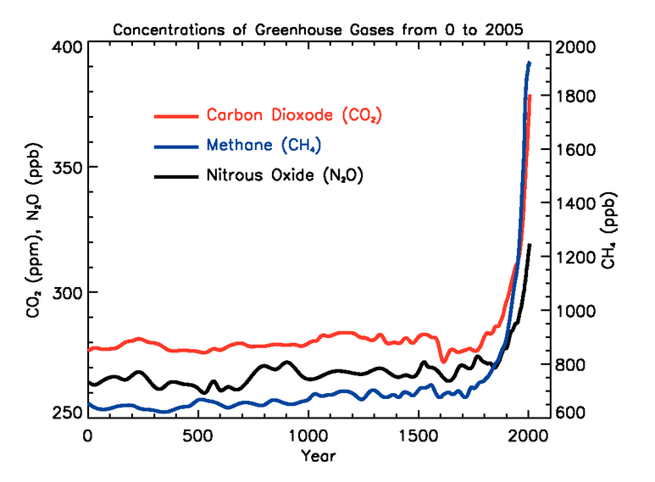
Human Impact: Greenhouse Gases
(IPCC, 2007)
Notes:
Even though the most important greenhouse gases occur naturally and are important for life on Earth, burning fossil fuels and other human activities have caused a large increase in their concentrations , especially the main greenhouse gases seen in this figure: carbon dioxide, methane, and nitrous oxide. Each of these gases has a unique relationship with agriculture, which we will discuss later.

Slide 6
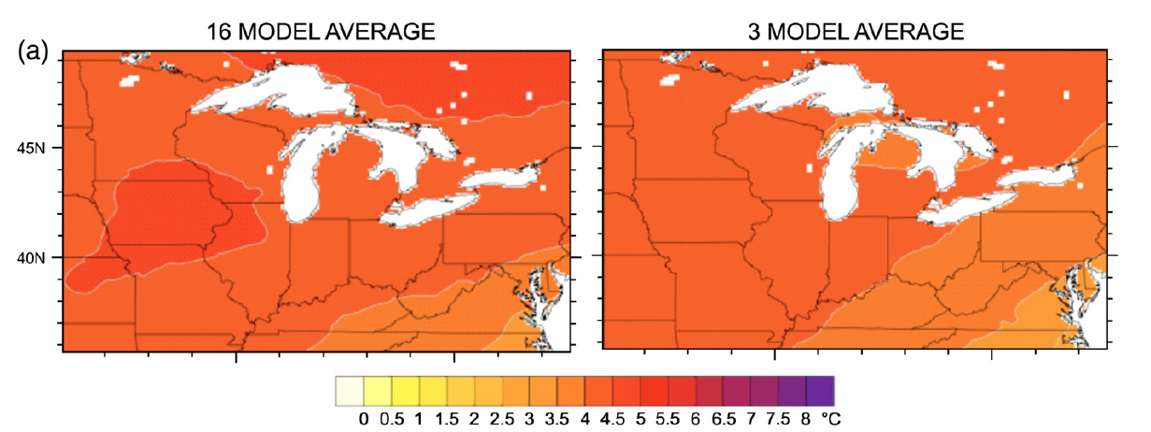
Temperature 2070-2099
(Hayhoe et al., 2010)
Notes:
Figure on the slide shows the rate of temperature change in the United States for the past century. Red color represents warmer whereas blue represents cooler than normal temperatures. Northeast, north central and southwest regions of the United States have experienced greater warming (1ºF to 4ºF) compared to the southeast United States which on the contrary experienced somewhat cooling trend. One of many factors contributing towards the opposite changes could be the land use changes in urban vs. rural settings. It is important to note that despite the fact that some region may experience cooling trend, the average temperature over the United States shows gradual warming as shown in the next slide.

Slide 7
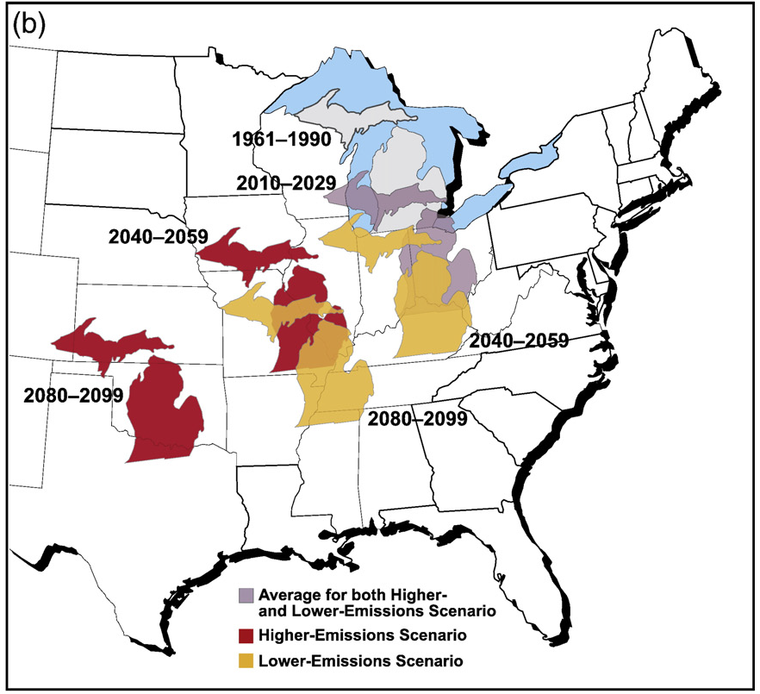
(Hayhoe et al., 2010)
Notes:
Fig. 9. Projected changes in summer average temperature and rainfall for Illinois and Michigan indicate that summers in these states will feel progressively more like summers
currently experienced by states to their southwest under both SRES A1fi higher (red) and B1 lower (yellow) future emissions scenarios. Both states are projected to warm
considerably and have less summer rainfall.

Slide 8
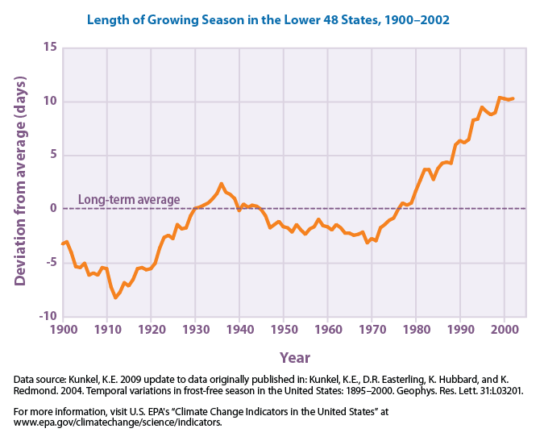
Notes:
The average length of the growing season in the lower 48 states has increased by about two weeks since the beginning of the 20th century. A particularly large and steady increase occurred over the last 30 years.
The length of the growing season has increased more rapidly in the West than in the East. In the West, the length of the growing season has increased at an average rate of about 20 days per century since 1900, compared with a rate of about six days per century in the East
The final spring frost is now occurring earlier than at any point since 1900, and the first fall frosts are arriving later. Since 1985, the last spring frost has arrived an average of about four days earlier than the long-term average, and the first fall frost has arrived about three days later
On a positive side, longer growing season indicates earlier shifts in planting dates and potentials for choosing longer season varieties.

Slide 9
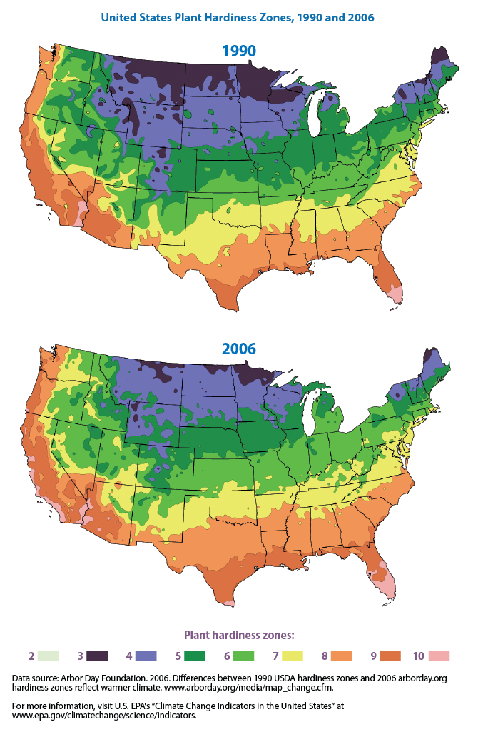
Notes:
This map is divided into numbered zones based on average annual low temperatures in10-degree increments. For example, areas in Zone 7 have an average annual minimum temperature of 0 to 10°F, while areas in Zone 8 have an average annual minimum temperature of 10 to 20°F. Each zone represents group of plant species that can be sustained with respect to minimum temperatures. Comparison between hardiness zones of 1990 and 2006 shows how these zones are shifting upwards across the United States. In other words, plants that are sustained in current situation might not be sustained in the future due to climate change.

Slide 10
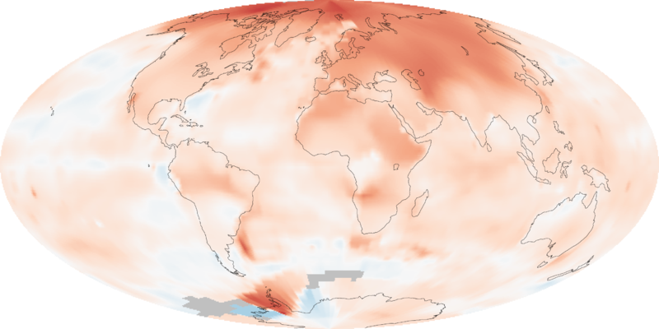
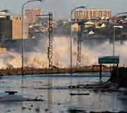
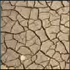
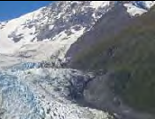
Global Warming
Climate Change
Increase in the average temperature due to increased concentrations of greenhouse gases in the atmosphere.
Changes in climate variables such as precipitation, snow, and wind patterns, sea level, extreme events in addition to temperature changes.
Notes:
Is global warming is same as climate change? Not exactly! Global warming represents only temperature increase on a global scale; whereas climate change refers changes in climate variables such as precipitation, snow, and wind patterns, sea level, extreme events in addition to temperature changes. Additionally, climate change term doesn’t only talk about changes at global scale but also at the regional scale. So climate change is a more complete term as opposed to the global warming and that is the reason why climate change is used quite often in a scientific community.

Slide 11
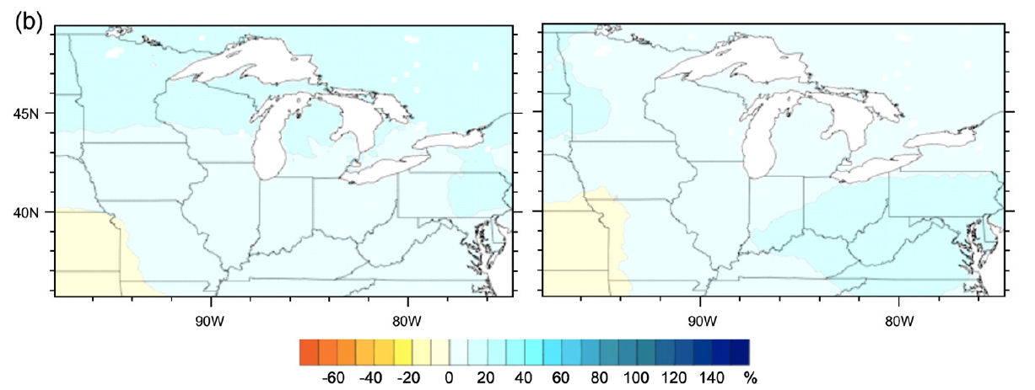
Precipitation 2070-2099
(Hayhoe et al., 2010)
Notes:
Figure on the slide shows the rate of temperature change in the United States for the past century. Red color represents warmer whereas blue represents cooler than normal temperatures. Northeast, north central and southwest regions of the United States have experienced greater warming (1ºF to 4ºF) compared to the southeast United States which on the contrary experienced somewhat cooling trend. One of many factors contributing towards the opposite changes could be the land use changes in urban vs. rural settings. It is important to note that despite the fact that some region may experience cooling trend, the average temperature over the United States shows gradual warming as shown in the next slide.

Slide 12
Projected Changes in Daily Precipitation
2081-2100 vs. 1981-2000

Slide 13
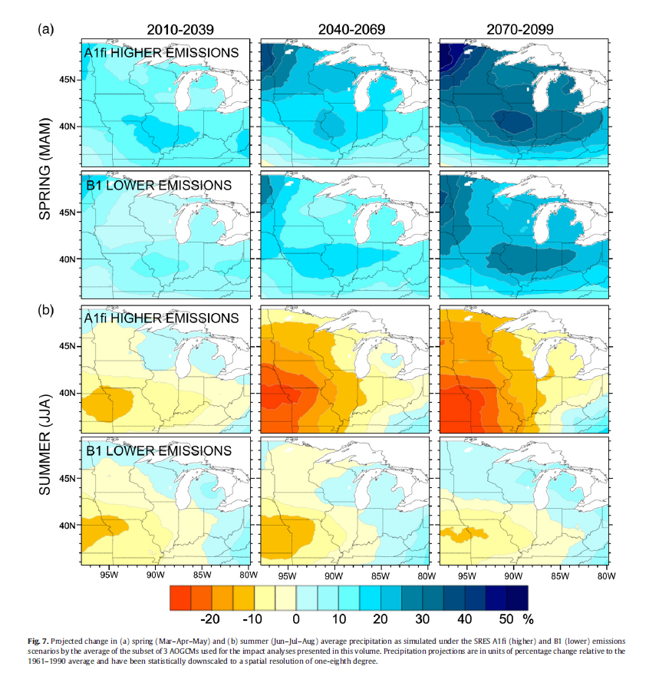

Slide 14
How can climate change impact growers?
Temperature
Precipitation
Extreme events
Cloud cover
Carbon dioxide levels
Planting and harvest times
Plant growth and development
Weed, disease, & insect outbreaks
Water quantity and quality
Irrigation needs
((Tubiello et al. 2007))
Notes:
Agronomists, plant pathologists, entomologists, and others are concerned about the effect of the changing climate on agriculture. Long-term data shows changes in temperature, cloud cover, precipitation, extreme events, and carbon dioxide levels. All of these affect agriculture directly. They affect plant growth, planting and harvest times, weed/disease/and insect outbreaks, irrigation needs, and soil and water quality directly. How will agriculture need to adapt? What’s the net effect? There is lots to consider….more than just temperature and it is not easy to predict exactly what will happen, as these variables interact in complicated ways. For example, while greater rainfall and a longer growing season can enhance crop growth, they can also lead to more plant pests. In addition, if the greater precipitation occurs in winter rather than summer, then the longer growing season may not enhance yields and may delay springtime soil drying. If, on the other hand, the greater precipitation occurs in summer but in more intense storms, the benefit may be offset by nitrogen loss, erosion, and other fertility problems. This highlights a really important point: the issue is complex.

Slide 15
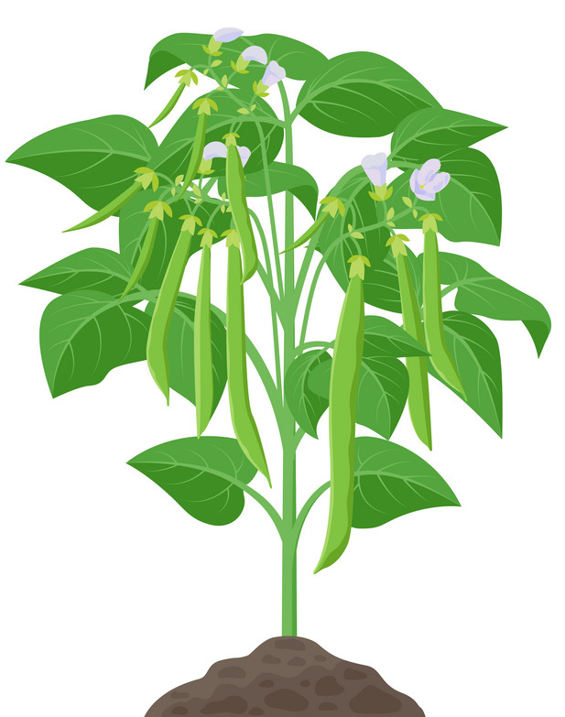
Adaptation for MI Dry Beans
An already resilient crop
Flexible growth habit
Fixes atmospheric N
Benefits from CO2 enrichment
Adaptation to drought
Beed new tolerant cultivars
Plant earlier in the year
Improve irrigation
Move production northward
Notes:
A simple definition of climate change adaptation is ‘the idea that changes are occurring or will occur, and we can manage the impacts of those changes.” We all know farmers are better than most at adapting. They have always adapted, and always will. But the changes we’ve seen over recent decades in the climate are unlike previous changes, and the rate of change is likely to increase, which may make adapting more difficult.

Slide 16
Objectives
Investigate drought tolerance of dry bean cultivars adapted to organic production in Michigan, including N fixation and yield
Share climate data, projections and research results with Michigan dry bean producers
Gather grower and expert input to improve understanding of potential risks and benefits of climate change in MI dry bean systems

Slide 17
Methods
Two locations in Chatham and East Lansing, MI
4 dry bean varieties, including R-99 a non-nodulating mutant
Planted June 11 (UP) and June 20 (EL) at 120,000 seeds/acre
Plots 25’ long with 14” (UP) and 30” (EL) row spacing
No N fertilizer applied, only K and S
Rainout shelters installed R1-R2 over half of each plot
Precipitation and soil moisture monitored weekly

Slide 18
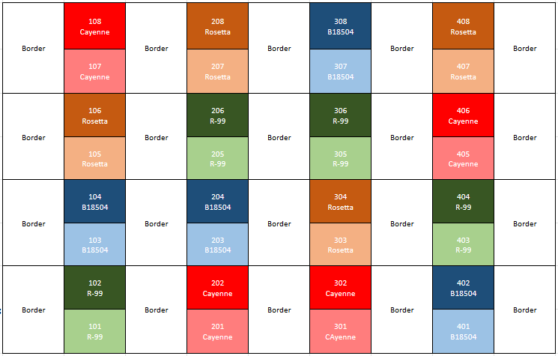

Slide 19
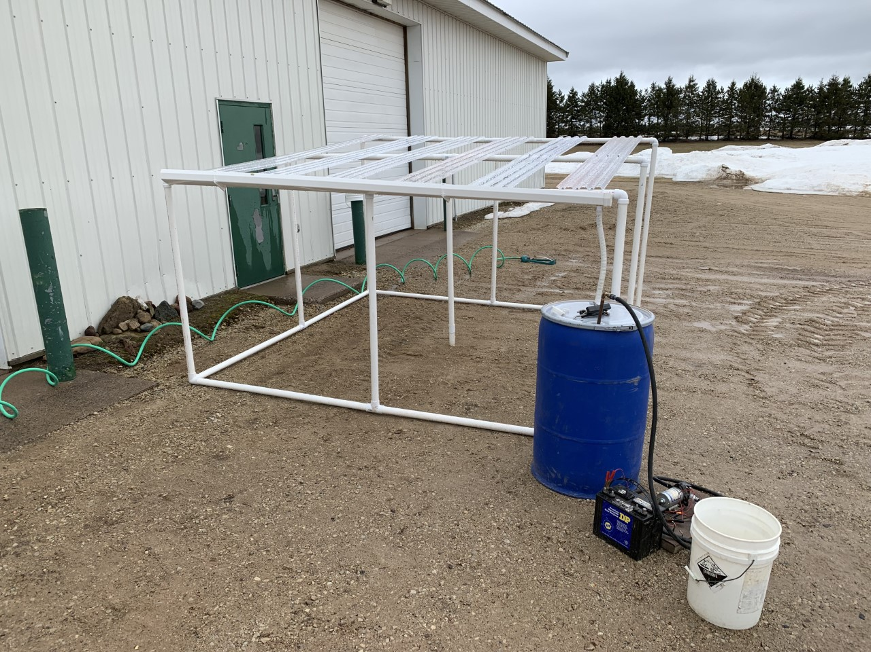

Slide 20
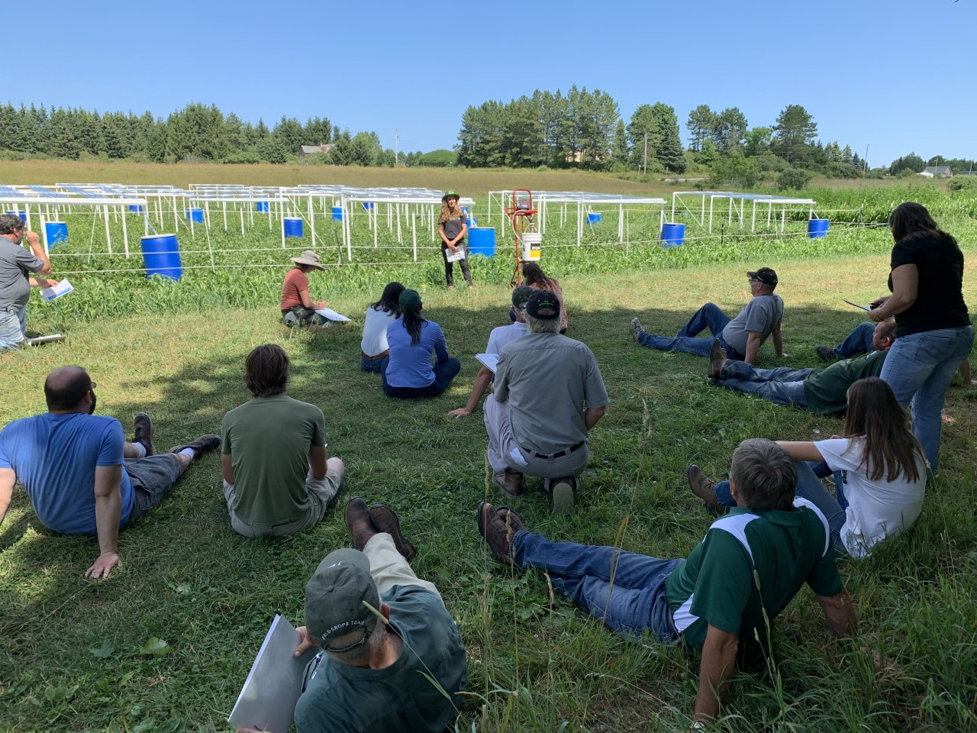

Slide 21
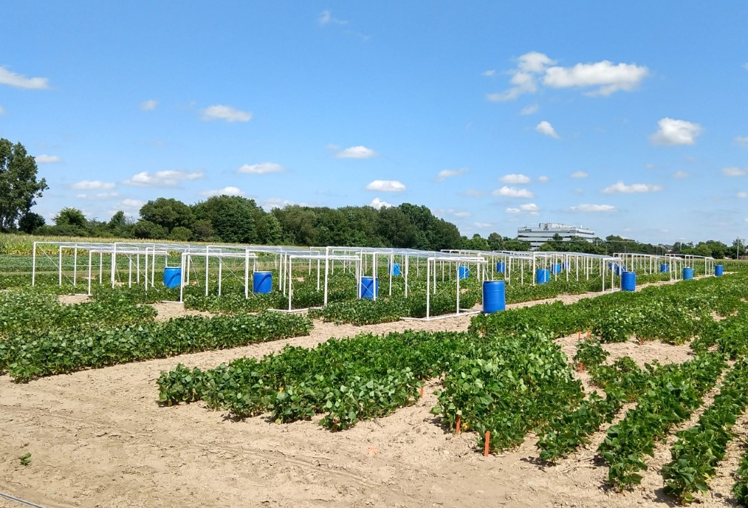

Slide 22
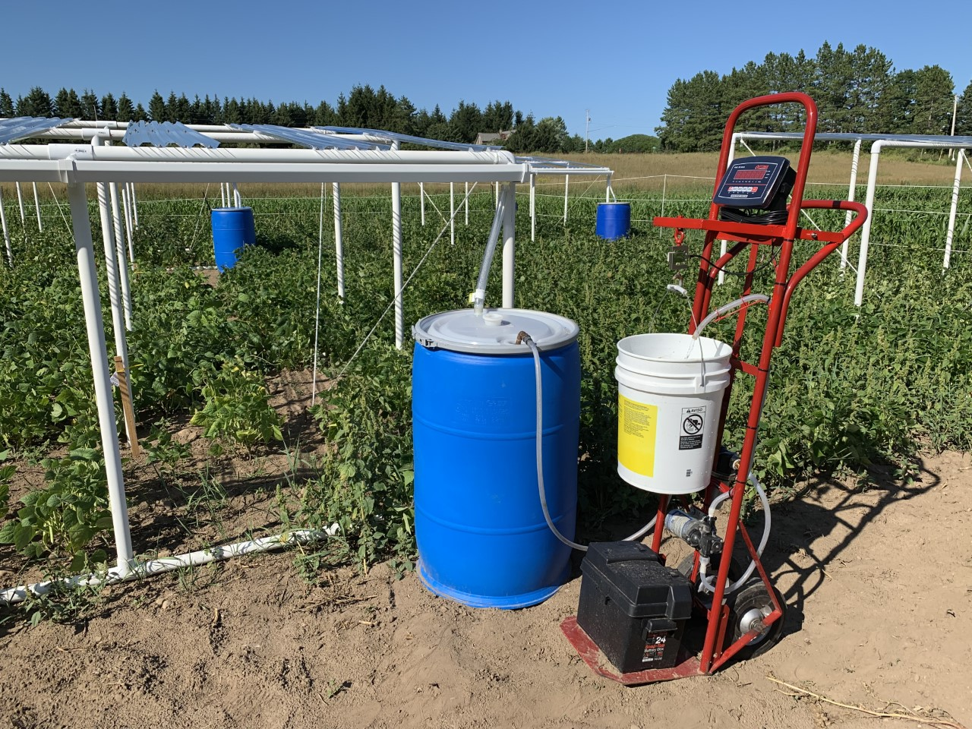

Slide 23
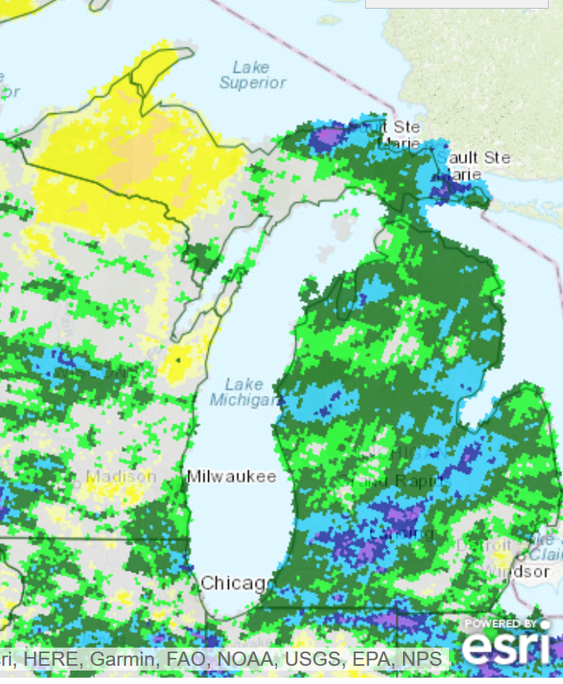
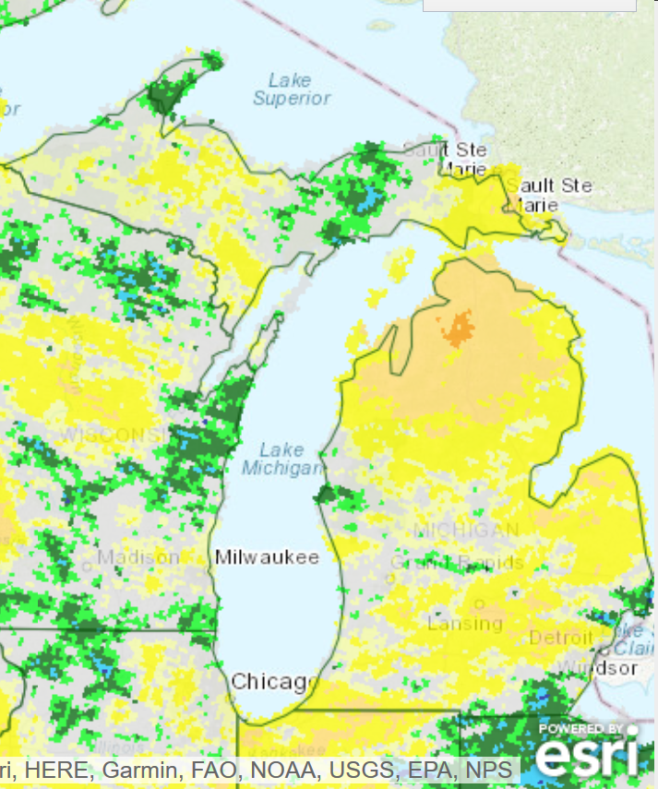
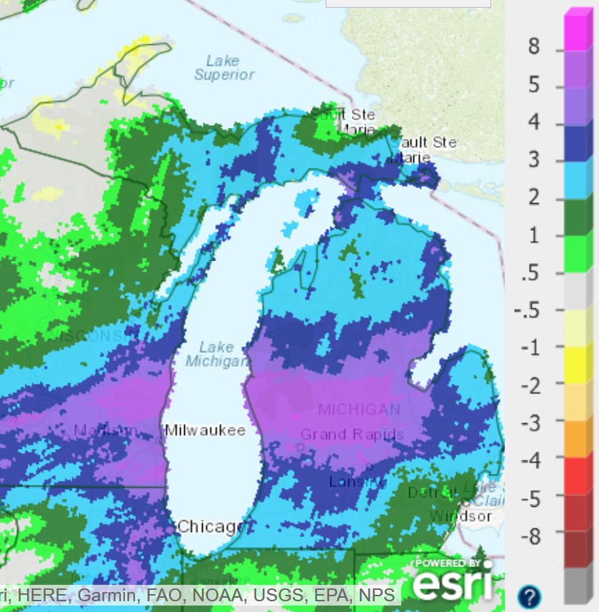
2019 Precipitation vs. Normal
June
August
September

Slide 24
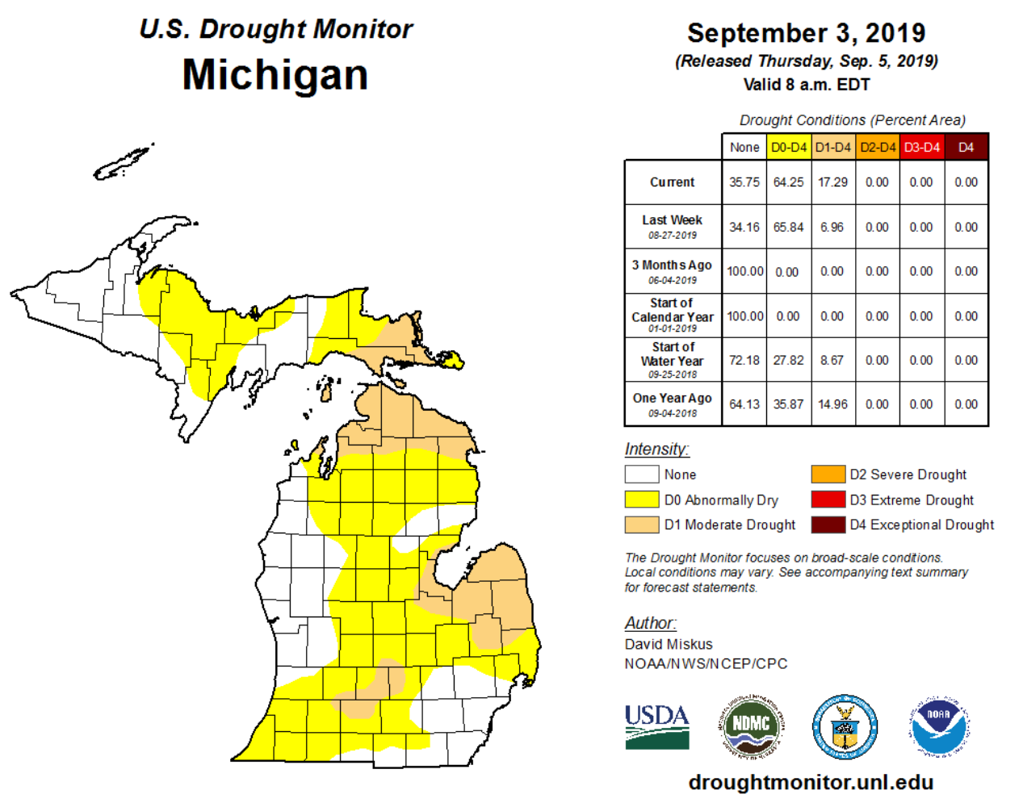

Slide 25
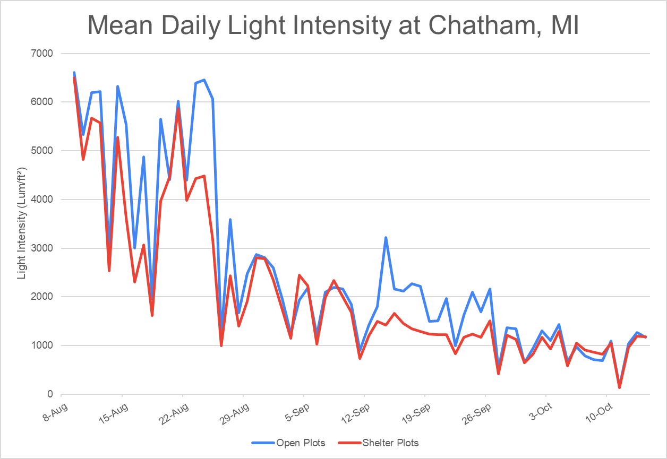
85% Avg. Light Transmission

Slide 26
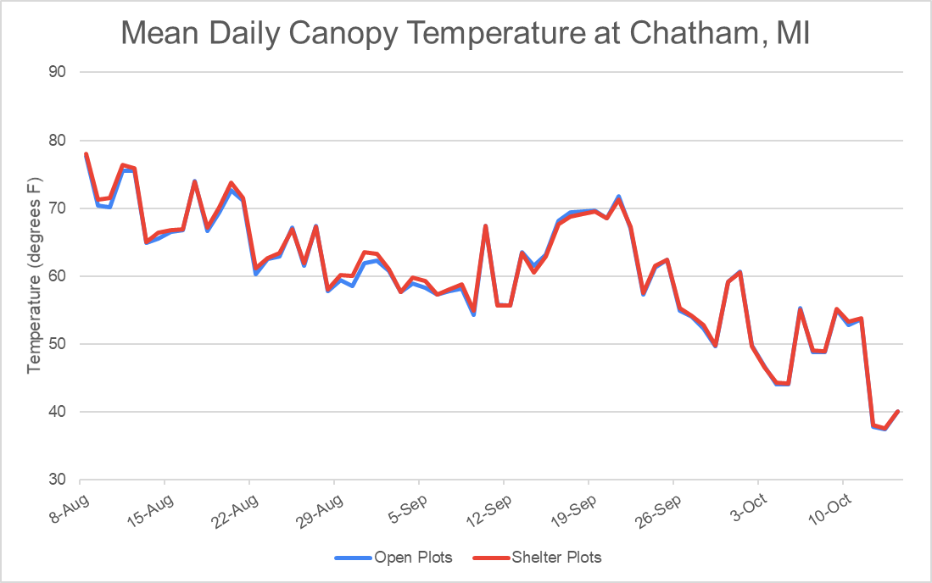

Slide 27
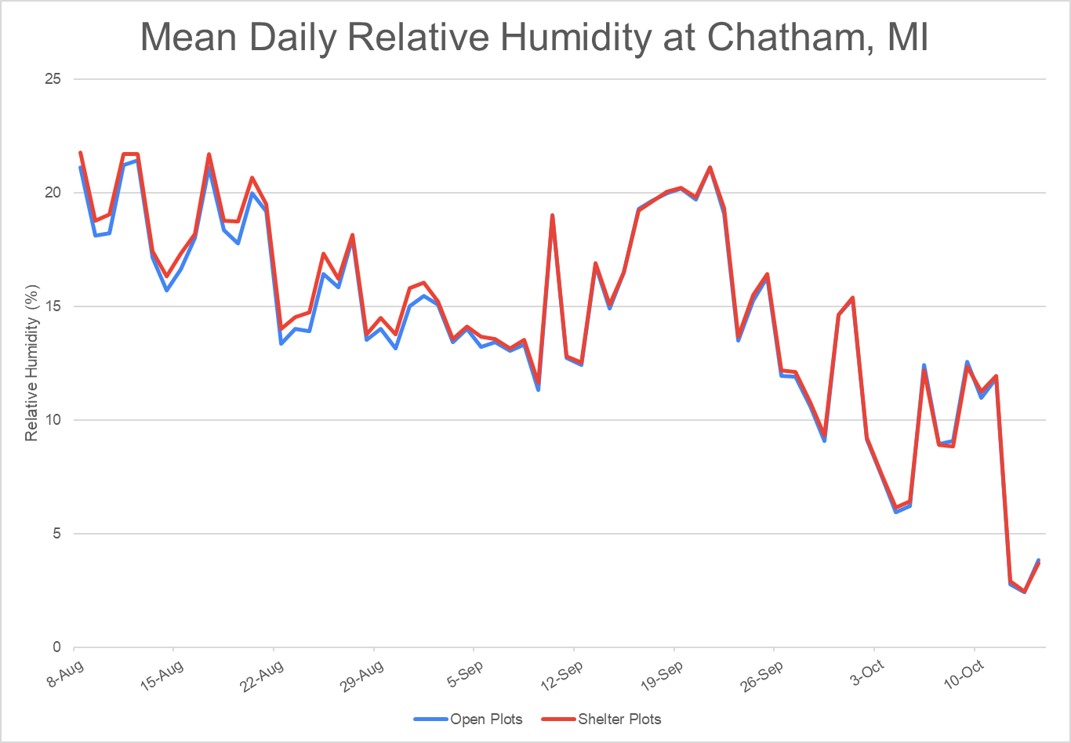

Slide 28
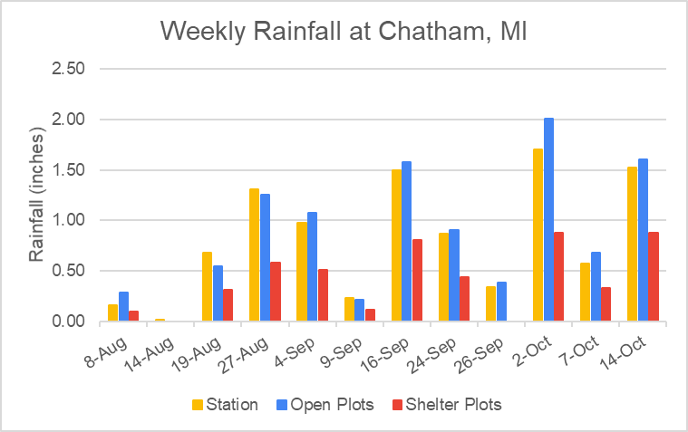
49% Avg. Reduction in Precipitation

Slide 29
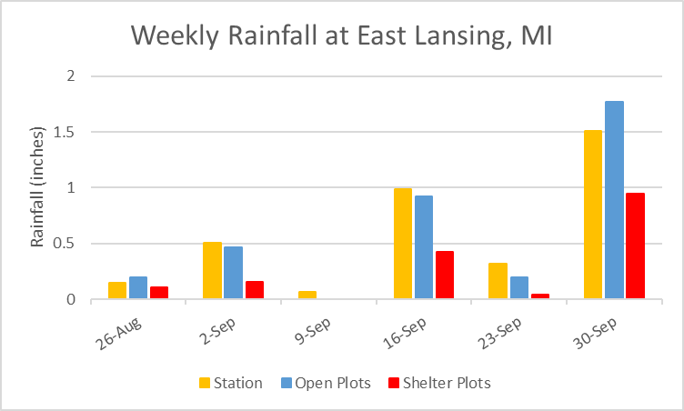
58% Avg. Reduction in Precipitation

Slide 30
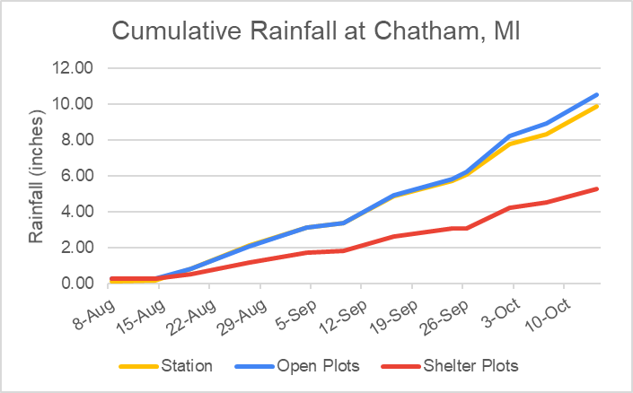
50% Reduction in Total Precipitation

Slide 31
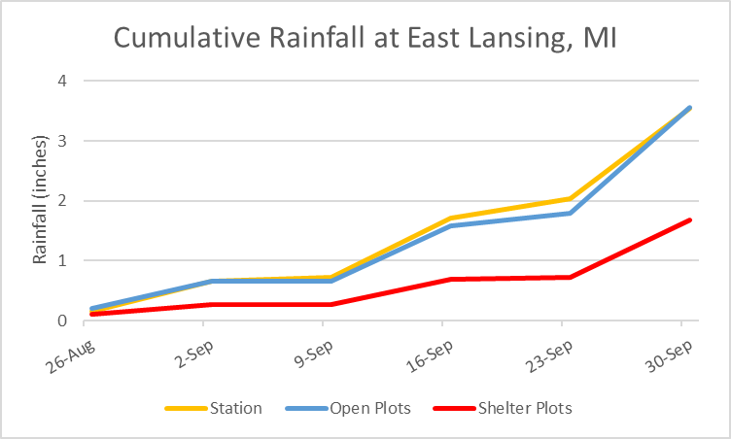
53% Reduction in Total Precipitation

Slide 32
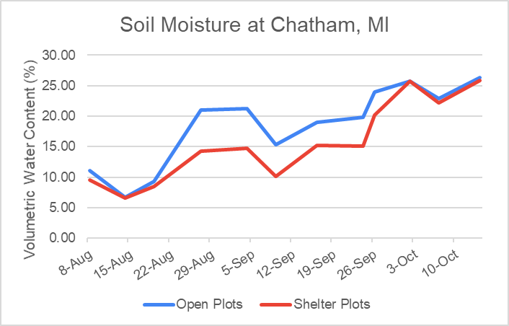
15% Avg. Reduction in Soil Moisture
Stress
Wilting Point

Slide 33
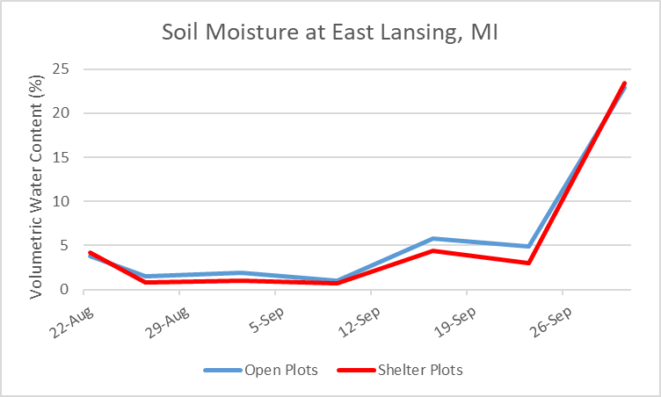
25% Avg. Reduction in Soil Moisture
Stress
Wilting Point

Slide 34
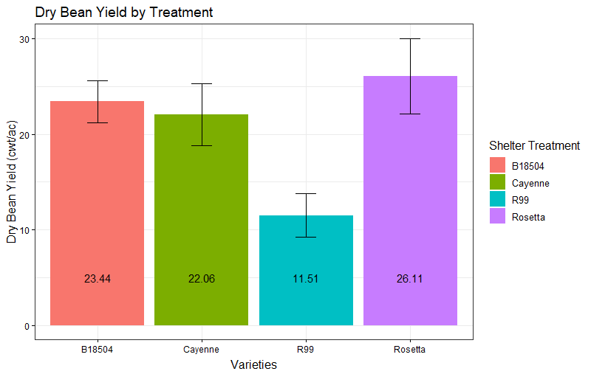
Dry Bean Yield by Variety at Chatham, MI
a
a
a
b

Slide 35
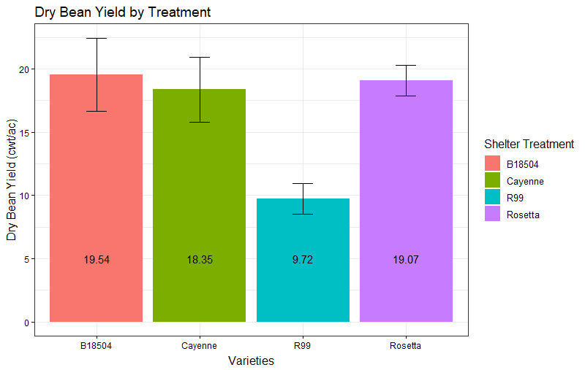
Dry Bean Yield by Variety at East Lansing, MI
a
a
a
b

Slide 36
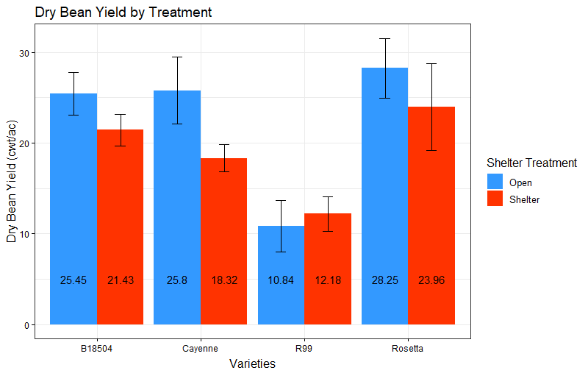
Dry Bean Yield by Treatment at Chatham, MI
a
a
a
b
a
b
a
a

Slide 37
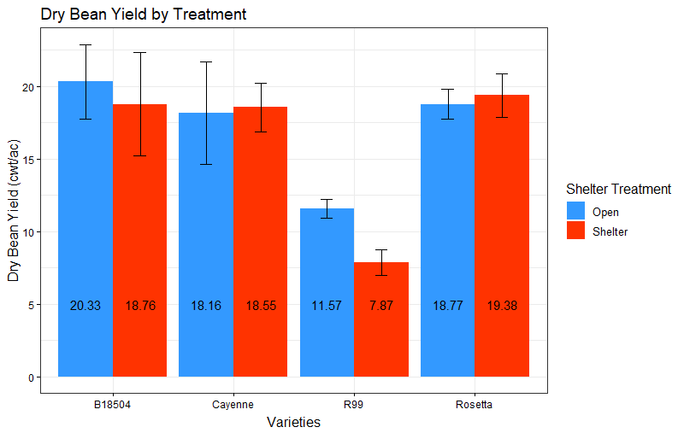
Dry Bean Yield by Treatment at East Lansing, MI
a
a
a
a
a
a
a
a

Slide 38
Conclusions and Next Steps
Achieving controlled soil moisture conditions is challenging with static rainout shelters, no irrigation
N fixation is important for yield, esp. in organic
Of the four varieties, Rosetta yield was least affected by drought
Still analyzing effect of treatment on maturity, height, N fixation and seed microbiome
Opportunities for northward expansion of MI dry bean production exist
GLISA dry bean climate impact scenarios project

Slide 39
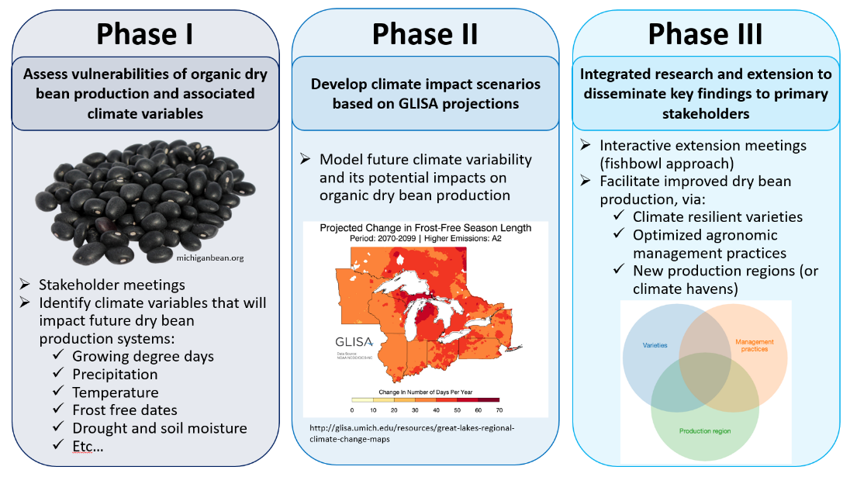
GLISA Climate Impact Scenarios

Slide 40
Acknowldegements
MSU Plant Resilience Institute
Jim Kelly and Andrew Wiersma
Chris Kapp and Evan Wright
Joe Charlebois, Andy Bahrman, Allison Stawara
Erin Burns
GLISA

