Slide 1
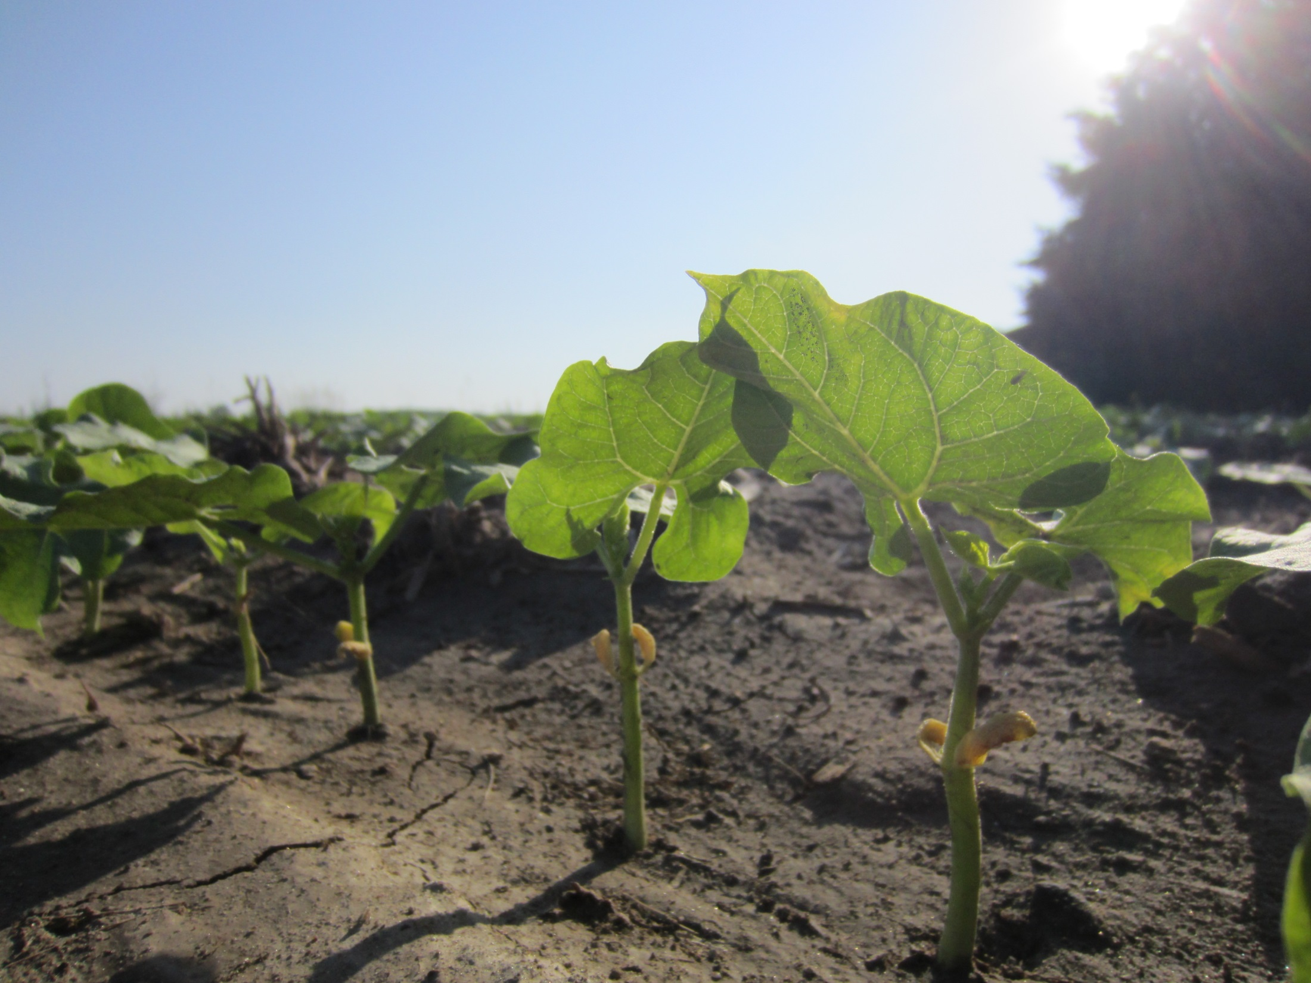
Dry Bean Meeting Dec. 11, 2019

Slide 2
The Season of 2019…
Fertility
Herbicide Resistance
Disease
Insects

Slide 3
4 R’s of Nutrient Stewardship
Right Source of Nutrients
Right Rate
Right Time
Right Place

Slide 4
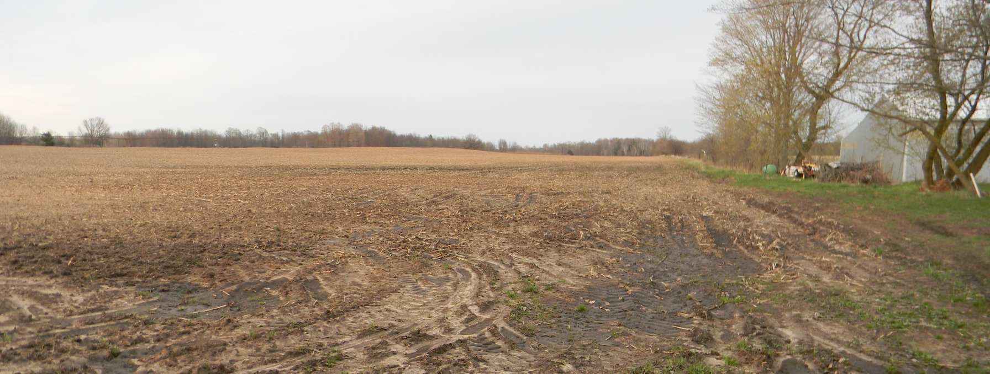
Starting With The Basics
Soil Test, Soil Test, Soil Test!
Grids
Straight
Understand your lab recommendations

Slide 5
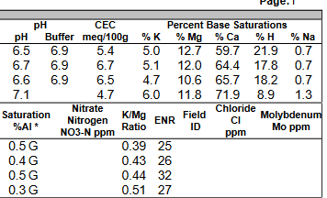
Soil Sampling

Slide 6
Why Grid Sample

Slide 7
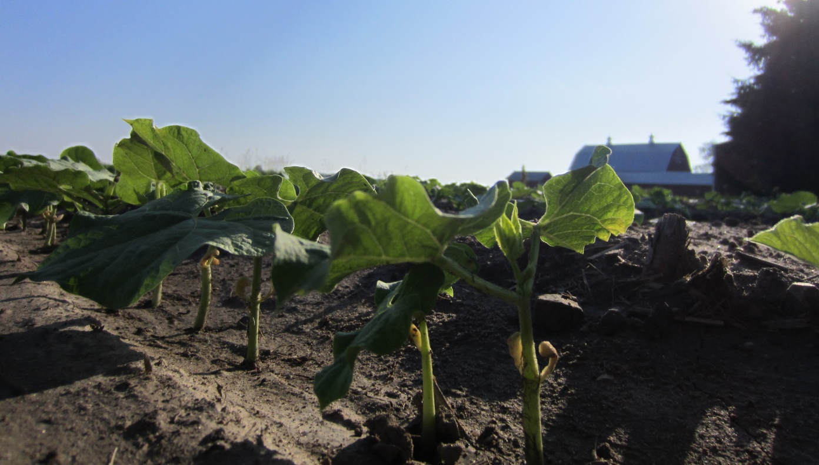
Dry Bean Nutrient Uptake
Yield goal of 30 bags per acre (pounds per acre)
N | P₂O₅ | K₂O | S | Ca | Mg
125 | 40 | 45 | 9 | 5 | 6

Slide 8
General Recommendations
N | P₂O₅ | K₂O | S | Mn | Zn | B
60-75 | 0-90 | 30-140 | 5-20 | 0-7 | 2 – 4.5 | .5
N – Plant will make some of it’s own N; don’t over load your soil

Slide 9
General Recommendations
N | P₂O₅ | K₂O | S | Mn | Zn | B
60-75 | 0-90 | 30-140 | 5-20 | 0-7 | 2 – 4.5 | .5
P – Most soils here are high in phosphates; make sure some is in the starter
K – Based on soil levels and how much is needed to build upon
Mg – Based on soil levels

Slide 10
General Recommendations
N | P₂O₅ | K₂O | S | Mn | Zn | B
60-75 | 0-90 | 30-140 | 5-20 | 0-7 | 2 – 4.5 | .5
S – 5:1 N:S ratio
Mn – 1 qt/acre in a liquid starter or foliar program
Zn – keep soil levels adequate; 1 qt/acre in liquid starter; foliar program
B – Assists with pod fill; broadcast or foliar; keep away from the seed

Slide 11
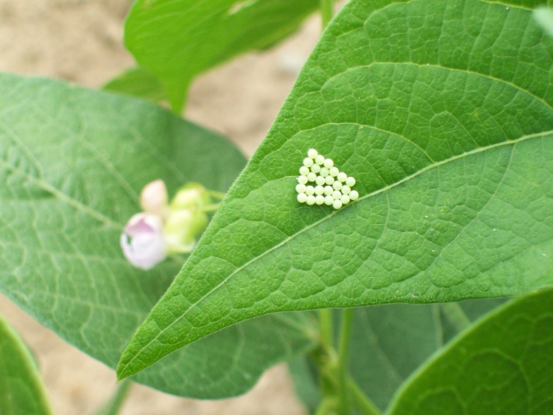
Other Fertility Options
Foliars
Root rot or other visual issues are present
Will NOT replace a good agronomic program
Can go on with fungicides or insecticides
20-20-20 plus micros
Ndemand Kman
18-0-6-3S-.1B-1Mn-.25Zn
Tissue Sampling
Biologicals
Lots of products on the market
Keep your soils balanced and bugs will be happy

Slide 12
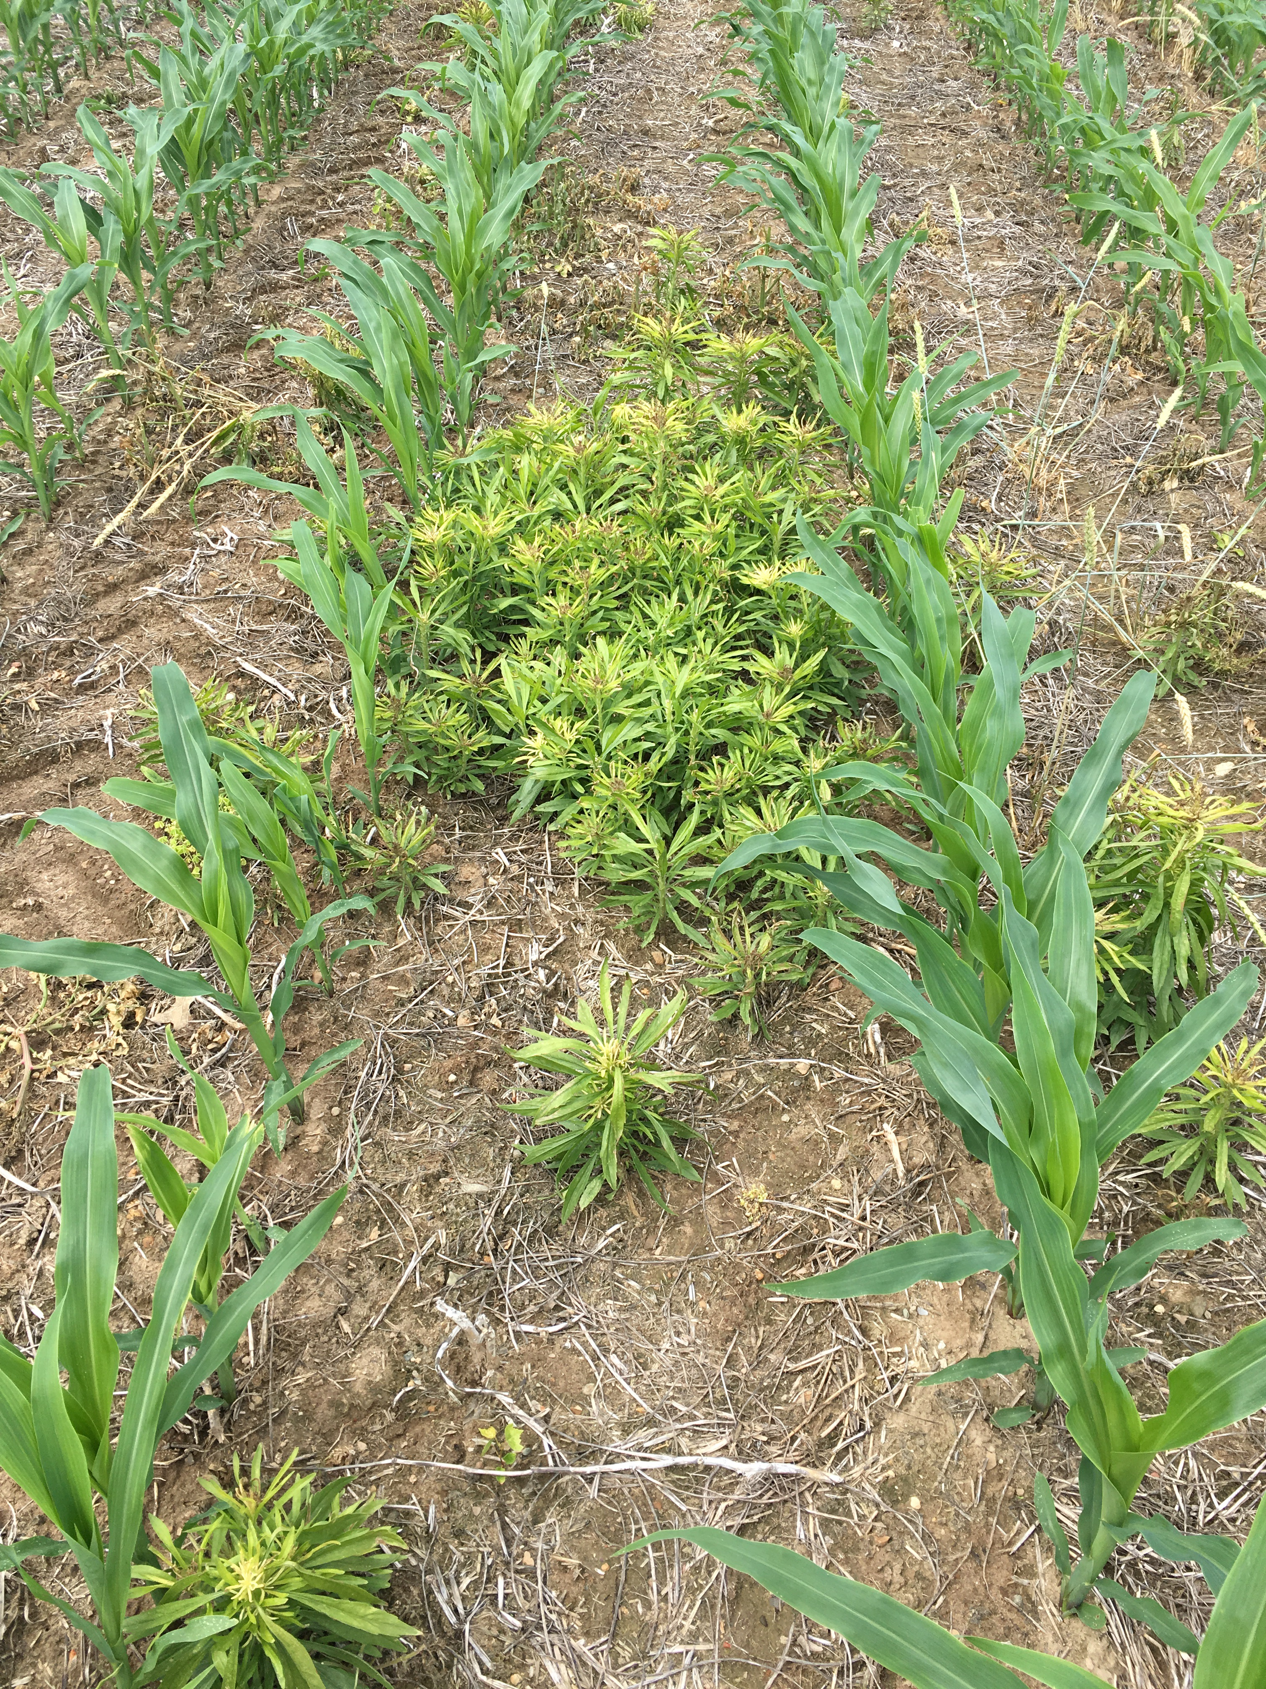
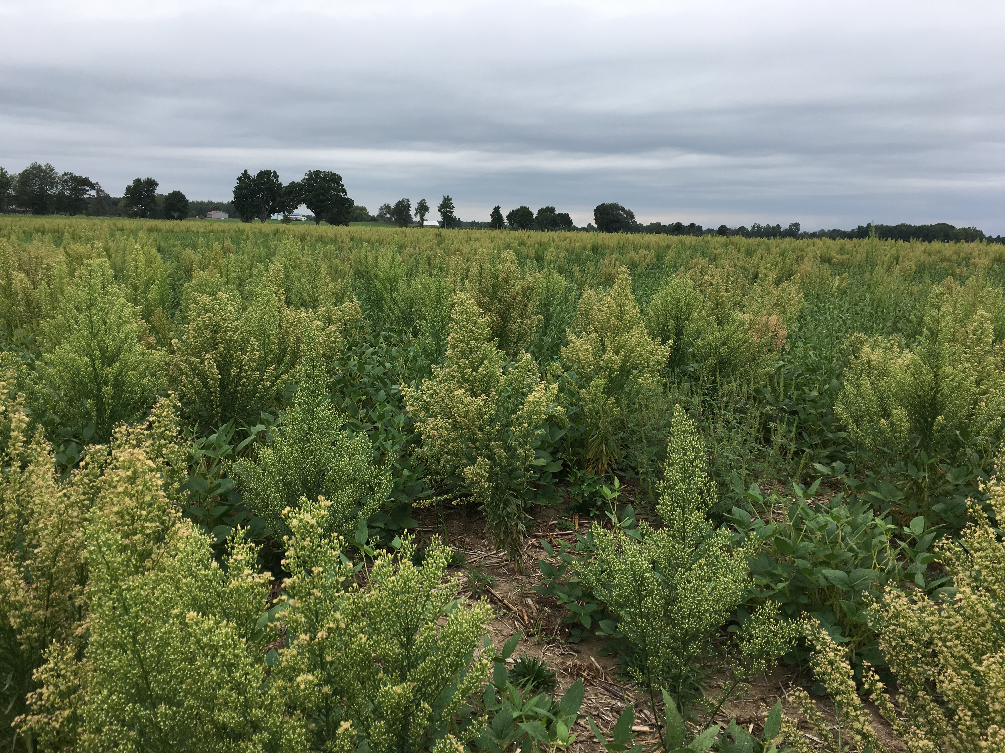
Herbicide Resistance
Know your fields
ALS (2) and glyphosate (9) resistant weeds are around
Test weed escapes
Rotate effective herbicide chemistries
Multiple modes of action
Layer chemistry = Pre followed by Post
Don’t wait to see weeds
Think about burndowns (fall/spring)
Tillage considerations
Cover crops
Nothing “new” for dry beans

Slide 13
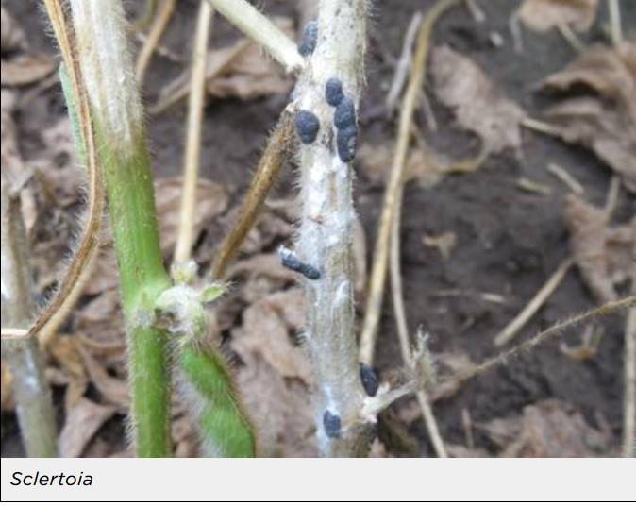
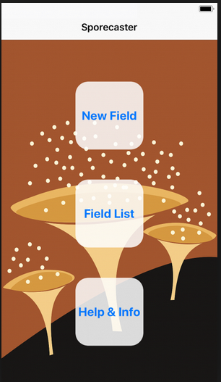
Diseases
Root Rot– high soil moisture, soil compaction, poor drainage and short rotations
Crop rotation – 3 years or more best
Good rotations: barley, corn, alfalfa and wheat
Good seed bed prep – bury trash in the fall, avoid compaction
Treat your seed
Wait to plant (60 F soil temp min)
Proper fertility gives plants the best start possible. (Nitrogen applications can help)
Herbicides like Dual, Prowl and Treflan can suppress root expansion in cool weather.
Avoid possibility for root pruning during cultivation
Cover crops that improve soil structure or reduce soil compaction
White Mold– dense crop canopy, rainy, wet weather around and during flowering
Get better air circulation
Wider rows and proper seed spacing
Rotation to non-host crops – corn and small grains
Sclerotian can survive in the soil for years following infestation
Don’t over fertilize with nitrogen
Manage irrigation closely
Fungicides are preventative, not curative
Proper fungicide timings
Sporecaster App

Slide 14
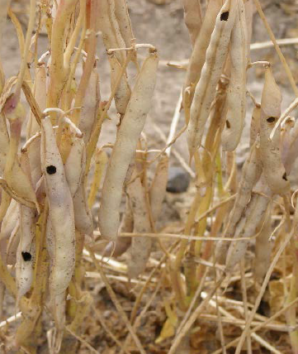
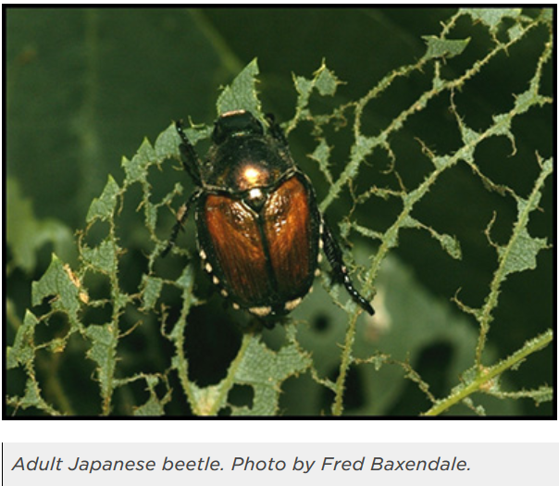
Insects
Japanese Beetles
Typically seeing adults in dry bean fields.
Emerge and feed June - August
They feed on leaves towards the top of the plants.
Threshold: 25-30% defoliation across the field.
Not recommended to spray.
Insecticides kill ALL bugs, both good and bad!
Western Bean Cutworm
Watch the traps
Maps can be found at https://www.cornpest.ca/wbc-trap-network/interactive-map-of-weekly-wbc-trap-catches/.
Scout your fields
Dry weather makes it difficult for the eggs to survive.
Insecticide applications should start 7-14 days after peak flight

Slide 15
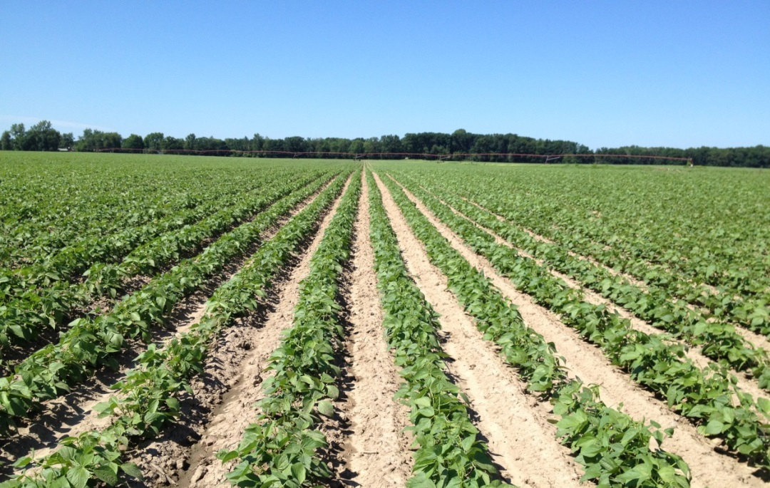
Summary
Take care of your soils – Soil Sample
Develop a good base program
There are multiple ways to get to the end result
You have to decide what works best for your farm

